Slide 1
The Justice Institute of British Columbia
Welcome Visitors!

Slide 2
WHO ARE WE?
Justice Institute of British Columbia (JIBC)
  Canada’s leading public safety educator
  Founded in 1978
  Six campuses: New Westminster, Maple Ridge, Chilliwack, Okanagan, Pitt meadows, and Victoria
  Deliver programs in 90 communities in B.C., Canada and around the world

Slide 3
VISION & MISSION
Our Vision
Safer communities and a more just society.
Our Mission
Developing dynamic justice and public safety professionals through exceptional applied education, training, and research.

Slide 4
What do we Offer?
Certificates, diplomas & degrees
Expert instructors
Small class sizes
Hands on training
Student support
Student loan eligible programs
Awards, bursaries, & scholarships

Slide 5
Program Areas
Counselling & Capacity Building
Community Safety
Paramedicine
Continuing Professional Health Education
Conflict Resolution, Mediation, & Negotiation
Leadership
Fire Safety and Prevention
Emergency Management
Security and Law Enforcement
Investigation and Bylaw Compliance
Municipal Policing
Sheriff and Court Administration
Corrections, Family and Community justice
Public Safety, Applied Leadership and Administration

Slide 6
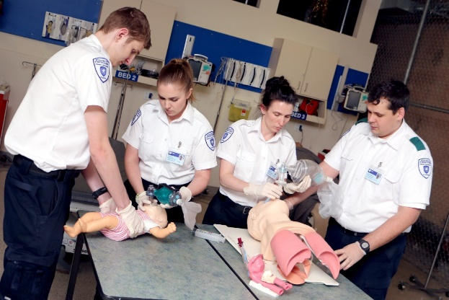
Health Sciences Division:
Paramedic Academy

Slide 7
Emergency Medical Responder
Emergency Medical Responder (EMR) Certificate
  *Must be 16 years of age/ Grade 10 Completion
  Valid for 3 Years
The Emergency Medical Responder course is a prerequisite course for the Primary Care Paramedic program.
Three weeks or 15 day Course
  Full-time weekdays
  Part-time weekend
  Available at 5 JIBC campuses

Slide 8
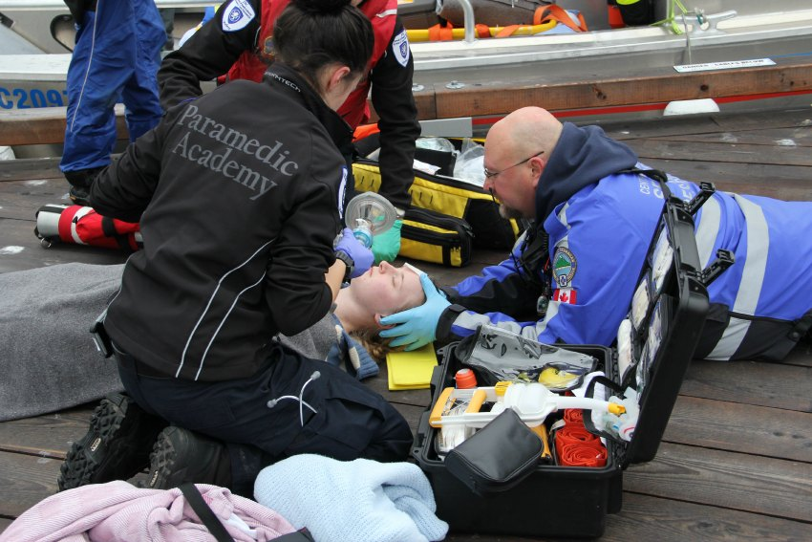
Emergency Medical Responder
This course focuses on the skills needed to respond to trauma and medical emergencies.
Training also includes the
fundamentals of:
  Anatomy
  Physiology
  Pathophysiology
  Pharmacology
  & Medical terminology

Slide 9
Primary Care Paramedic
The PCP program is an entry-level paramedic training program providing the skills and knowledge required to practice as a Primary Care Paramedic.
Focuses on the skills required to
assess and manage patients in a pre-hospital care environment
strengthen the decision-making and treatment actions required to care for critically ill or injured individuals in a pre-hospital setting

Slide 10
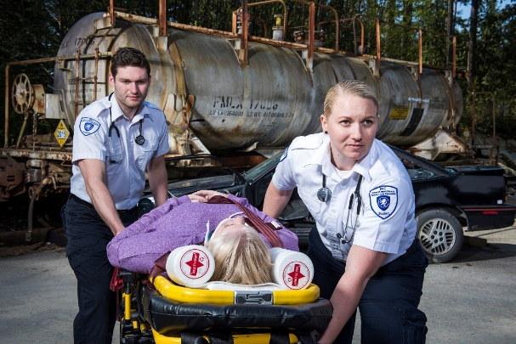
Primary Care Paramedic
Primary Care Paramedic (PCP) Certificate Program
8 Month full-time program
  Admission Requirements
    Grade 12 graduation (or equivalent)
    English 12 (minimum grade of C)
    & Various other requirements! www.jibc.ca

Slide 11
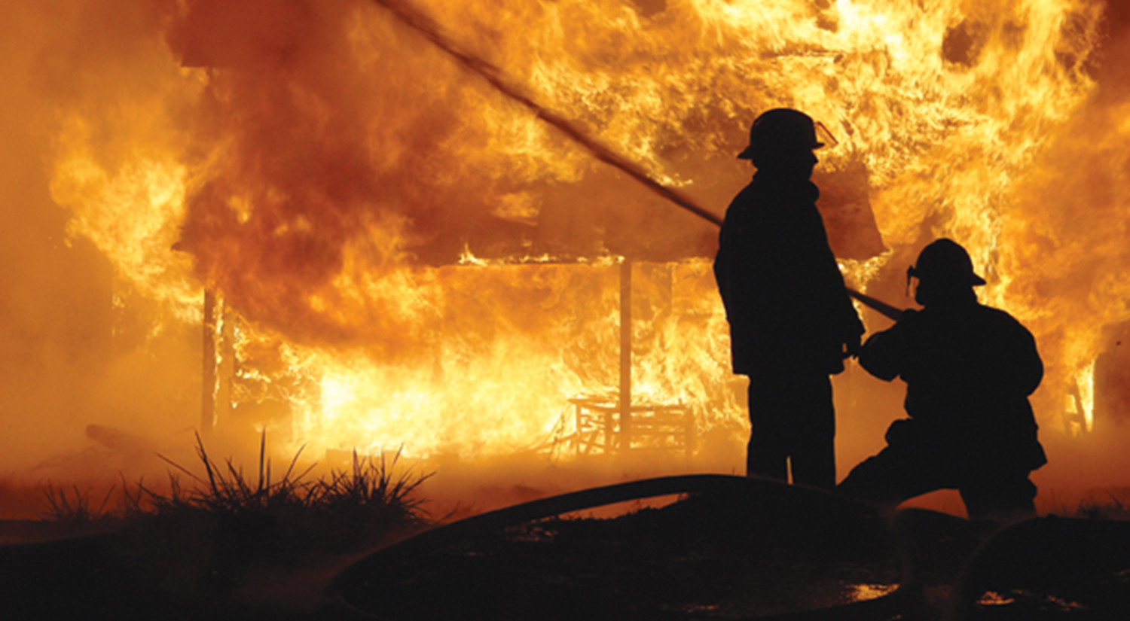
Fire & Safety Division:
Fire Fighting Certificate (FFTC)

Slide 12
FIRE FIGHTING TECHNOLOGIES
The Fire Fighting Technologies Certificate program will provide you with:
Theoretical background
Applied skills
NFPA certification
Graduates are employment-ready and are able to take on the challenges of an entry-level fire fighter.

Slide 13
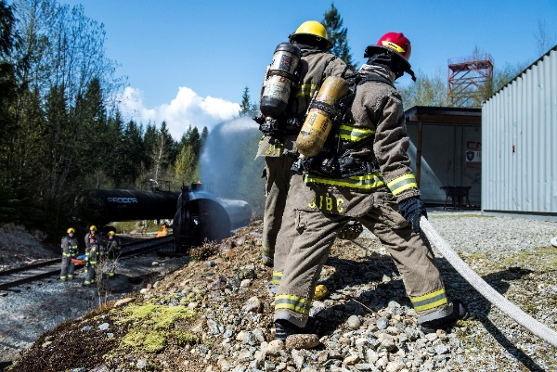
FIRE FIGHTING TECHNOLOGIES
Fire Fighting Technologies Certificate
Twelve weeks of online courses anywhere (self-paced, progress tracked & supported)
Seven weeks of practical training & evaluation takes place at the Maple Ridge campus + one week of hazmat
OR
10 part-time weeks + 2 full-time weeks + one week of hazmat (R19)
NFPA 1001= Standard for firefighter professional qualifications for career & volunteer firefighters.

Slide 14
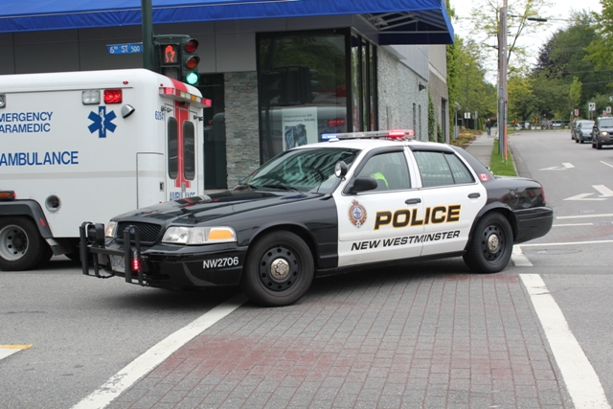
Law Enforcement Studies
Diploma

Slide 15
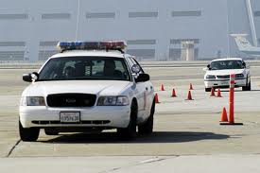
Law Enforcement Studies Diploma
Law Enforcement Studies Diploma program will provide you with:
Theoretical background
Applied skills
Specialized knowledge

Slide 16
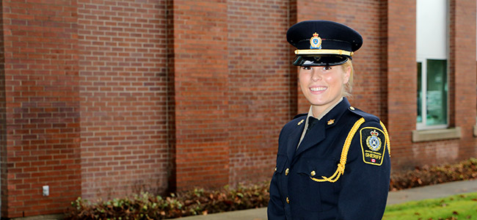
Law Enforcement Studies Diploma
Law Enforcement Studies Diploma
  Full time 2 year program
  Offered at the New Westminster campus
  Opens the door to various law enforcement careers
  Police Officer
  Private Security
  Sheriff Services
  Corrections

Slide 17
Bachelor of Law Enforcement Studies
4 Year Bachelor Degree
Additional 2 years once the Law enforcement Diploma is completed
Offered full-time at the New Westminster campus
Also offered online
Great for those that are looking for growth and promotion in their selected careers

Slide 18

Emergency Management Division

Slide 19
Emergency Management Programs
Have you lived through a disaster?
What did you notice going on around you?

Slide 20
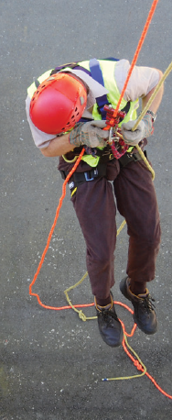
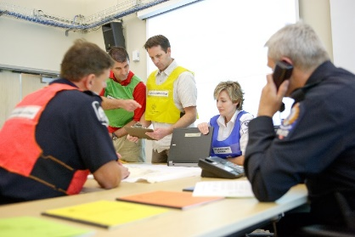
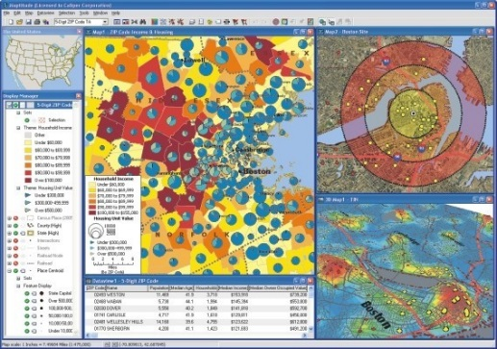
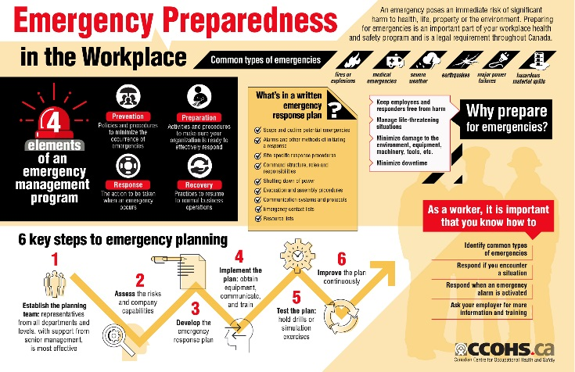
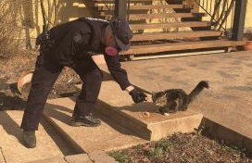
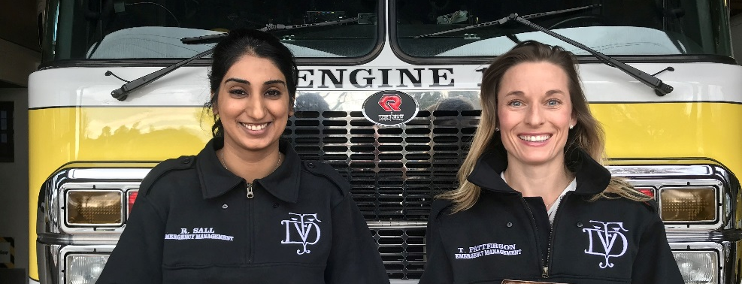
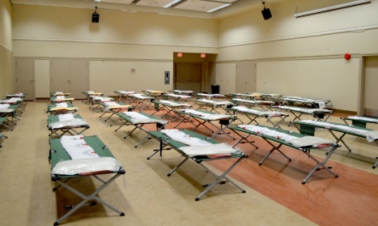
What is Emergency Management?

Slide 21
What do emergency Managers do?
Emergency management focuses on preparing communities and agencies for disasters
Write emergency plans
Manage an Emergency Operations Centre
Organize community groups
Work with vulnerable communities
Interpret laws
Create business continuity plans
Create disaster simulations
Use social media
Protect heritage items
Plan for recovery
Meet with mayor and council
Create GIS maps
Help people and animals during disasters

Slide 22

Asst. Manager, Safety & Emergency Mgmt.
Translink
$85,068 - $106,335
Develops and manages customer and occupational safety policies & programs, and supports the company-wide emergency management program.

Slide 23

Readiness & Security Program Officer
Government of Canada
$97,825
Responsible for ensuring the Consulate General of Canada in New York is always in a state of readiness to respond to international emergencies affecting Canadian communities abroad.

Slide 24

Public Safety & Security Coordinator
George Brown College
$57,703 - $72,129
Responsible for incident investigations, reporting on threats, hazards &incidents, tracking & maintaining College records for legal proceedings.

Slide 25

Emergency Planning Coordinator
Toronto Public Health
$94,421 - $110,929
Responsible for developing and maintaining components of the Toronto Public Health Emergency Plan and assigned emergency support functions, and other risk specific plans.

Slide 26

Emergency Management & Fire Safety Officer
Wilfrid Laurier University
$65,137 - $76,603
Responsible for developing the University’s Emergency Response Plan, and maintaining and communicating emergency preparedness measures and strategies.

Slide 27
Emergency Management
I want to be done in:
4-6 months
Certificate in Emergency Management
I want to be done in:
2-3 years
Diploma in Emergency & Security Management
I want to be done in:
4-5 years
Bachelor of Emergency & Security Management Studies
jibc.ca/cem
jibc.ca/desm
jibc.ca/besms
All programs are entirely online, offered part-time and full-time!

Slide 28

Community & Social Justice:
-Conflict Resolution
-Counselling & Community Safety
-Leadership

Slide 29

About Our Courses
  Flexible
  Part-time
  Continuous intake
  Good value
  Pass/fail
  Online (Live and Self-Access)
“JIBC courses provided me with skills to critically navigate conflict situations and to work toward a collaborative solution. The tools I learned have enabled me to act with intention, rather than out of habit, which has made me a better leader.”
– Selena B.
Notes:
Travis
Accommodating – one course a year or complete an entire program
Flexible - Fit your schedule and budget (part-time); online, face to face, blended; 1-5 days
Continuous intake – not just sept start – popular courses offered each month
Good value - For price per credential and credit we are in the middle of the pack – equal to the average price of all the institutions and organizations we researched.
Where we see the great value of JIBC courses is when we look at the cost per training hour. We are lower than the average cost per hour and that means that students who choose JIBC get better value for their money and more face to face training for the money compared to most other post secondary institutions and organizations.
Professional development
Adult learning

Slide 30
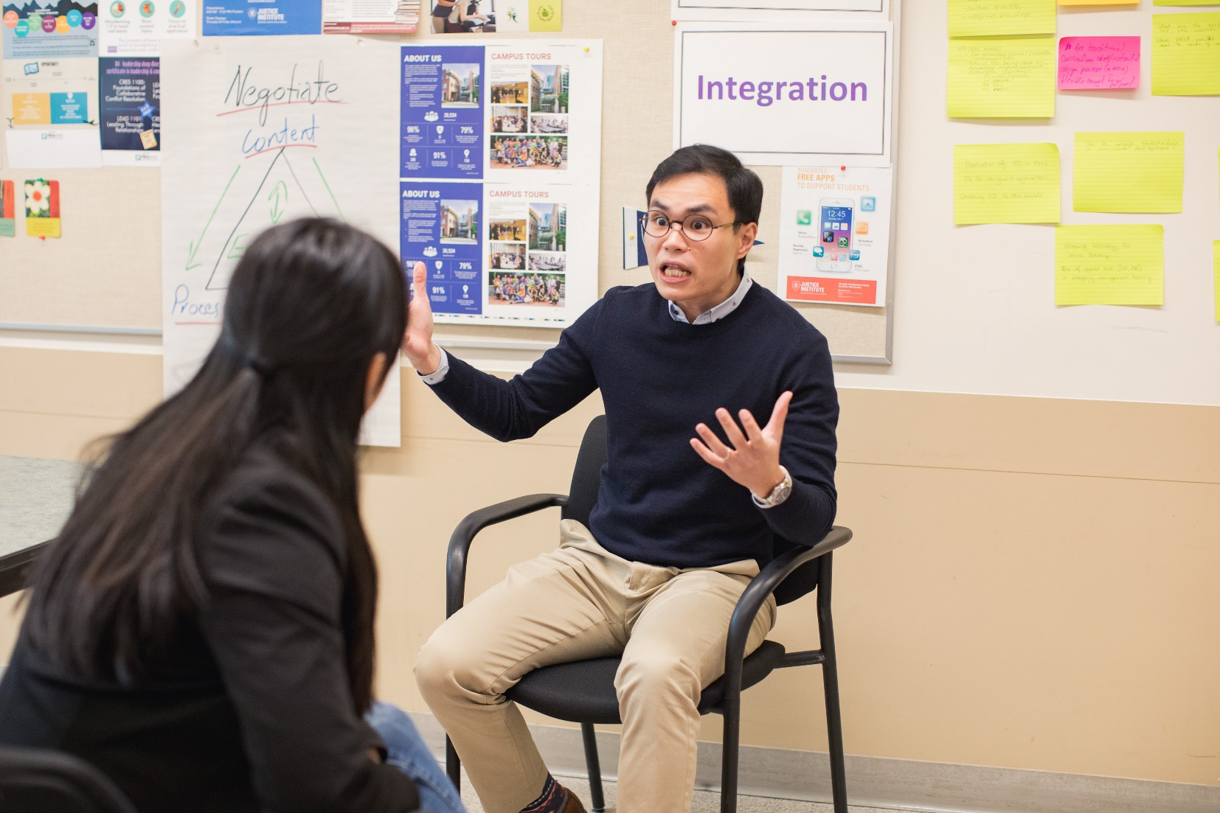
Centre for Conflict Resolution
Associate Certificate in Conflict Coaching (12 days)
Certificate in Collaborative Conflict Resolution (40 days)
“The JIBC has transformed my natural gifts and talents into a marketable skill set which I can now tactfully deploy to achieve learning outcomes while earning a fair wage.”
–Monique G.
“The JIBC has transformed my natural gifts and talents into a marketable skill set which I can now tactfully deploy to achieve learning outcomes while earning a fair wage.” –Monique G.
Notes:
Travis

Slide 31
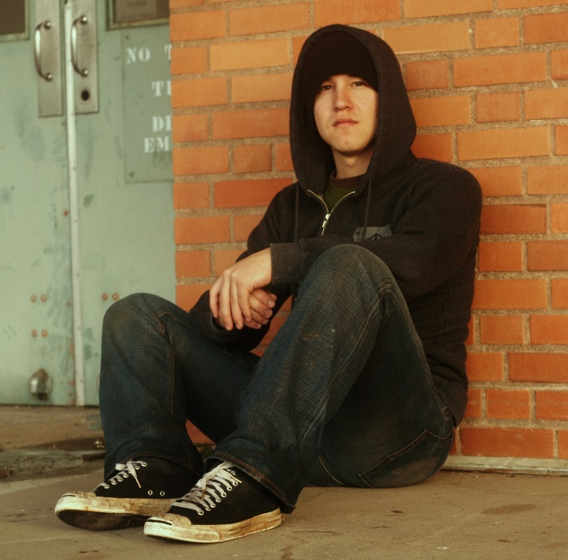
Counselling & Capacity Building
Enhanced skills and training for practitioners, frontline workers and those in community safety roles, who support families and communities affected by traumatic life situations.
  Trauma & Trauma Informed Practice
  Expressive Play Therapies
  Motivational Interviewing
  Indigenous Trauma

Slide 32
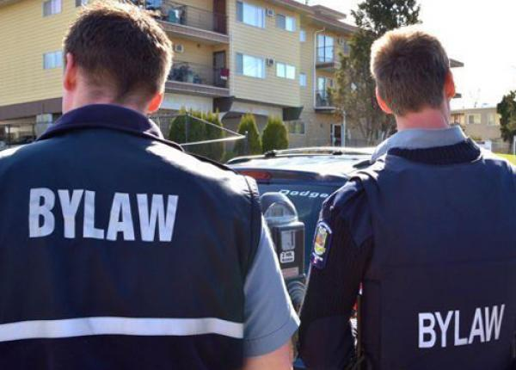
Community safety
Bylaw Compliance, Enforcement and Investigative Skills
Develop skills and knowledge to work within British Columbia's bylaw enforcement field:
BLAW-1000 (Level 1): 6 weeks self-paced online learning + 3 days full-time virtual learning
BLAW-1005 (Level 2): 6 weeks self-paced online learning, +3 days of full-time learning @JIBC New West
Critical Incident Stress Management
Effectively manage critical incidents and the emotional health and safety of those involved in traumatic events

Slide 33

Centre for Leadership
Associate Certificate in Leadership & Conflict Resolution (12 training days)
Certificate in Applied Leadership (20 training days)
“It has allowed me to be introspective and explore how to lead with integrity. I would recommend courses to anyone who is looking to improve their leadership skills, which include self-reflection, critical analysis of situations and collaborative conflict resolutions.”
- John T.
Notes:
Sarah
Assoc Cert Training and facilitation: $3.8 K (5 courses) new program designed for people who train or facilitate either in formal situations in their workplace or informally – one on one coaching and training – or who are interested in doing more of this type of work moving forward. And for those who want to step up into a leadership role and facilitate meetings in your place of work or community
Associate Cert Lead & CR: $3K (4 courses) this pulls together both con res and leadership courses; the basis of this certificate is the foundation courses in both areas so it can be a good place to start. It will ladder into certificates in both leadership and conflict resolution
CAL: $4.8K (7 courses) both seasoned and emerging leaders; begin the process with yourself – who you are as a leader and how that impacts those around you; strengths, challenges, how to build on those skills; then you work you way out – how you lead in relationships – look at concepts around team building and situational leadership; enhance your skills around coaching conversations; continue to move outward and look at how you can have influence in your organization from whatever position – and along the way you learn techniques to encourage creativity and innovative thinking within your team.

Slide 34
Possible Career Opportunities
Policing
Firefighting
Paramedics
First responders
Private Security
Corrections
Border Services Agency Official
Sheriffs
Emergency Manager
Emergency Management Planner
Disaster Response Coordinator
Fraud Investigator
Mediator
Bylaw enforcement
Conservation Officer

Slide 35
Student services
ACADEMIC SUPPORT
  The Writing Centre
  Library Equipment and Facilities
  Learning Support and Study Skills Resources
  Disability Services
STUDENT LIFE
  Mental Health & Wellness Information
  Justice Institute Students’ Union

Slide 36
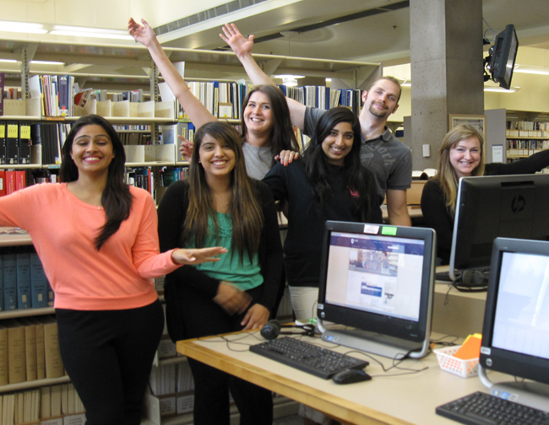
Library
Resources focus on a wide range of justice and public safety topics
Research help – in-person and online
Research skills classes
Laptop & iPad lending
Digital resources
  eBooks
  streaming media
Free mailing & curbside pick-up

Slide 37

OFFICE OF Indigenization
JIBC serves people and communities located in unceded traditional and treaty territories of First Peoples across British Columbia.
The Office of Indigenization provides holistic supports to First Nations, Inuit, and Métis learners to help you succeed in your studies.
SERVICES FOR INDIGENOUS STUDENTS
Career planning
Elders-In-Residence Program
Aboriginal Gathering Place
Access to traditional medicines
Indigenous activities and events
Access to financial aid, scholarships and bursaries
Email: Indigenization@jibc.ca

