Slide 1
EMRG-1600 Introduction to Emergency Support Services

Slide 2
We respectfully acknowledge the Justice Institute of British Columbia’s New Westminster campus is located on the unceded Traditional Territories of the qiqéyt (Qayqayt), xʷməθkʷəy̓əm (Musqueam) and Coast Salish people.
Notes:
We recommend including a land acknowledgement at the start of your presentation, or open the course in a good way. Your community or ESS team may already have a way they prefer to do this.
You can use the same format on the slide – change the location and the names of the territories for which you reside. You may also want to include actions that you, or your ESS team do to move towards reconciliation.
If you are unsure of the territories on which you reside, please visit https://native-land.ca/.

Slide 3
Housekeeping
Emergency Exits
Washrooms
Phone Use
Breaks
Materials
Notes:
Note to All Facilitators
Cover these items with the information specific to your training location, feel free to adjust according to you and your class.
Below is a template for how we recommend discussing these items:
Emergency Exits:
Direct people to where the emergency exits are
Washrooms:
Direct people to where the washrooms are
Phone Use:
Please do not use your phone during the session.
If you must take an urgent call or respond to an email, please leave the training room to do so and return when you are done.
Breaks:
There is one scheduled 15-minute break during this session <insert the time>
Please feel free to leave the training room at any time if you need a break before this time
Paperwork:
You should have a participant guide. This contains the content that we will be covering during this course as well as the activities we will be doing throughout the session.
There is a student information form at the back of the manual that you will complete and return to the facilitator at the end of the session. This required to receive a record of completion for the course.

Slide 4
Instructor Introductions
Instructor Name Here
Instructor Name Here
Information about instructor.
Information about instructor.
Notes:
Instructor Introductions (5 minutes)
Insert your introductions here.

Slide 5
Icebreaker Question
Notes:
Activity Objective: A quick icebreaker question to get students familiar with one another. Introductions should take between 30-60 seconds per participant.
Instructors are expected to keep the icebreaker section within the time specified in the lesson plan. Instructors should provide reminders to participants to keep their responses short if they are consistently taking longer than expected
Full Group Discussion (15 Minutes)
Select from one of the same icebreaker questions below:
Share your name and name of team
Share your name and how many years of experience you have in <field>
Share your name and the last role you had during a response/call-out

Slide 6
Learning Outcomes
Upon completion of this course, you will be able to:
Prepare to be an ESS responder
Explain the role and structure of ESS
Describe the rights and responsibilities of ESS responders
Notes:
Review what participants will be able to do after course completion.

Slide 7
Module 1: Preparing to be an ESS Responder

Slide 8
Emergency Support Services (ESS)
Emergency Support Services (ESS) provides short-term
basic support to people impacted by disasters.
The program is financed by the provincial government and administered by Indigenous communities and local governments.
ESS is designed to provide short-term support following disasters ranging from a single house fire to provincial level events involving large evacuations. These supports enable people to re-establish themselves as quickly as possible after an emergency or disaster.
Notes:
Provide a concise description of ESS.

Slide 9
What hazards may threaten your community?
Notes:
Group Discussion
Objective: For participants to have an understanding what hazards ESS responds to, and what types of hazards they may be responding to.
What hazards may threaten your community?
Students can share their answers as they feel comfortable.
Examples: Disease outbreaks, Earthquakes, Floods, Hazardous materials spills, landslides, power outages, Severe weather, Structural fires, Tsunamis, Wildfires
Emergencies and disasters happen at anytime and anywhere. Although disasters may cause damage to buildings, bridges, and other structures, they affect people in their communities in many ways – people may be injured, lives lost, homes destroyed, families displaced, financial losses incurred, etc.
An emergency is a situation caused by accident, fire, explosion or forces of nature that threatens people or property, and may require the response of more than one agency to protect the health, safety and welfare of people, or limit damage to property.
A disaster means a calamity caused by accident, fire, explosion or technical failure, or by the forces of nature which results in serious harm to the health, safety or welfare of people, or widespread damage to property.
According to PreparedBC (2023), it’s important to familiarize yourself with the potential hazards in your area. Knowing which hazards you may encounter will influence how you prepare.

Slide 10
Effects of Disaster on People
Factors Affecting Reaction to Loss
Circumstances, age, life experience, individual personality, value systems, beliefs, coping style, social and financial support
First Reactions
Shock, disbelief, disorientation, numbness, fear, reluctance to leave property
Post-Incident Reactions
Frustration, anxiety, anger, suspicion, irritability, apathy, depression, fatigue, isolation
Notes:
Discuss how disasters can impact evacuees, and people related to the disaster.
Disasters affect people in different ways. In some disaster situations it may mean loss of loved ones, including relatives, friends, neighbours, or family pets. In others, it means loss of home and property, furnishings, and important or cherished belongings. Sometimes it means starting over with a new home or business. The emotional effects of loss and disruption may show up immediately or appear many months later.
It is very important to understand that there is a natural grieving process following any loss and that a disaster of any size will cause unusual and unwanted stress in those attempting to reconstruct their lives. These stresses may cause a series of common reactions as noted in the following sections.

Slide 11
Plan for Self-Care
ESS responders may be exposed directly or indirectly to heartbreaking devastation and loss, and to the related stress and trauma
Responders may experience stress reactions during or after the response
Responders may feel overwhelmed
Notes:
Introduce self-care for responders.
ESS responders may be exposed directly or indirectly to heartbreaking devastation and loss, and to the related stress and trauma. Having a personal preparedness plan is vital to self-care and can affect how you react to these emotional demands depend on several variables including:
The circumstances of the disaster
The nature of the response environment and their role
Their level of preparedness
Any pre-existing personal stressors or trauma
Even experienced responders may at times feel overwhelmed and experience difficult stress reactions during or after the response.

Slide 12
Sources and Signs of Stress for ESS Responders
SOURCES OF STRESS
Event
Occupational
Organizational
Environmental
SIGNS OF STRESS
Loss of spirit
Ignoring policy
Cynicism
Apathy
Isolation
Irritability
Notes:
Discuss sources and signs of stress for ESS responders.

Slide 13
Activity: Planning for Self-Care
On Your Own
What activities would you engage in to care for yourself before, during, and after a response?
Notes:
Activity Objective: For participants to consider activities that will personally support their self-care.
On Your Own (5 minutes)
Complete the “Planning for Self-Care” activity in the participant guide.

Slide 14
Looking After Yourself
Before
Grab and go bag
Self-assessment prior to an assignment
During
Know who your supervisor is
After
Debriefs
Family emergency plan
Communicate with family/friends/employer
Sleep
Peer support
Self check
Take breaks
Stay fed and hydrated
Buddy system
Ask for help
Notes:
Discuss examples on how to practice self-care before, during, and after an event. Ask for examples from the participants that they came up with in the previous activity.

Slide 15
Discuss What You’ve Learned
[Add Discussion Question(s)]
Reflect on the discussion question(s)
Discuss your responses with a small group
Share with the large group
Notes:
Activity Objective: For participants to consider the discussion questions and be able to describe the responses
Instructions:
Select 1-2 of the discussion questions below and put them on the slide
What are steps you can take to prepare to be an ESS responder?
What are the most important ways to prepare to be an ESS responder for this team?
What is something that was unexpected to you about preparing to be an ESS responder?
On Your Own (2 minutes)
Have students consider the question
Suggest students record their thoughts on their Participant Guide
In small groups (5 minutes)
Student discuss their thoughts on the discussion question with their group
In a large group (5 minutes)
The class discusses their responses

Slide 16
Interacting with Evacuees

Slide 17
“For people who have been forced from their homes, it can be a scary and anxiety provoking experience”
“We are beyond stressed out and scared and I don't even know how to describe it and find the words right now”
CBC News(2023, August 18). Experts warn about effects of evacuations on mental health [online video]. Retrieved from https://www.youtube.com/watch?v=l7TPUHgmlhU&
Notes:
Discuss the following:
These are quotes from a recent wildfire evacuation.
Evacuees have lost control of what is happening to them, which can cause many different stressed and scared reactions.
Evacuation orders are a difficult experience.

Slide 18
What behaviours from an ESS responder would make you feel supported in the event of an evacuation?
Notes:
Purpose (share with group): We are asking these questions to begin to discuss evacuee interactions
Conclusions to reach from discussion:
Any themes that arise, especially as they relate to WADE, which will be discussed in the next slides (e.g. empathy)
People have different needs in evacuations
What works for you, may not always work for others

Slide 19
Notes:
Show this video for a definition and description of cultural humility.
https://www.youtube.com/watch?v=c_wOnJJEfxE&pp=ygUid2hhdCBpcyBjdWx0dXJhbCBodW1pbGl0eSBwc3ljaGh1Yg%3D%3D

Slide 20
Why is it important to consider Cultural Humility when working with evacuees?
Notes:
Group Discussion
Objective: participants to understand that their may be working with people from cultures that they are unfamiliar with, it is important to respect that their experience and understanding of things may be different from their own.
For example: You may prefer a specific restaurant or hotel, but an evacuee may have different cultural factors to consider when making those choices.

Slide 21
Interacting with Evacuees: WADE
W
A
D
E
Wait for Evacuees’ Responses
Give evacuees time to process answers
Respect silence
Ask What Evacuees Need
When possible, give evacuees options
Ask how you can assist
Don’t Assume
Do not assume: support needs, socioeconomics, identity, gender, or accessibility needs
Evacuee-Centered
Supporting the evacuee is at the centre of the work
Self/worker-care is evacuee care
Notes:
WADE is a framework that outlines suggested practices for working with evacuees.
This is important to consider within the frame of cultural humility, and in being sensitive to evacuees who have gone through a difficult experience.
Students also have been given a tipsheet that outlines WADE. Highlight this for them as well.
WADE
W – Wait for evacuee responses
There are many reasons evacuees may benefit from time to process answers
Leave silence for them to think and answer
A – Ask what evacuee’s need
It is better to give options as opposed to assume, but example “which grocery story will be better for you”
If you notice someone needs assistance, it is better to ask if they need help and how, as opposed to jumping in to do something
D – Don’t assume
Do not assume what kind of support people need (this related to the above, ask them what they need instead)
Do not assume someone’s identity and what support they may need based on the perceived identity
For example, someone may be dressed well, but are in need of support. It is not for the responder to judge or assume.
E - Evacuee-Centred
Supporting the evacuee is central to ESS
Focus on what the evacuee needs
If you aren’t sure how to support an evacuee, speak to a supervisor, another organization may be able to provide supports
All information is about the evacuee and they should be able to see what you are writing
Supervisors can also help come up with creative solutions
It is important to take care of yourself, if you are tired, or hungry, or frustrated, you won’t provide good care. Think about when you are being helped, you can tell when the other person is frustrated
Look out for yourself and one another, and accept when others are looking out for you

Slide 22
Module 2: ESS Overview

Slide 23
ESS Overview Summary
Describe the role of ESS in emergency management
Describe the role of each level of government in emergency management
List the British Columbia Emergency Management System (BCEMS) response goals
Describe the Incident Command System (ICS) guiding principles in ESS
List the basic and additional services provided by ESS
Describe the ESS activation levels
Discuss the ESS support organizations
Notes:
Explain that this is what will be discussed in Module 2.

Slide 24
Emergency Management
The systems and processes for preventing and mitigating, preparing for, responding to, and recovering from emergencies and disasters.
Notes:
Explain key points of emergency management.

Slide 25
ESS Director
The ESS Director is appointed by the local Emergency Program Coordinator. They are responsible for the management and coordination of a local ESS program/team, planning, and response activities.
Notes:
Explain the role of an ESS director (ESSD).

Slide 26
ESS Has a Vital Role in:
Assisting people to remain independent and self-sufficient
Assisting people to meet basic needs
Providing accurate and current information
Assisting people to re-establish themselves as soon as possible
Notes:
Explain the role of ESS in emergency management.

Slide 27
Local Authority Responsibilities
The Emergency Program Act, legislates municipalities and regional districts to be responsible for planning and managing emergency response operations within their jurisdiction.
In BC, the Emergency Management Regulation requires local authorities to coordinate the provision of food, clothing, shelter, transportation, and medical services for their residents.
Notes:
Explain the role and responsibilities of local authorities in emergency management.
Under the Emergency Program Act, Local Authorities in BC, including both municipalities and regional districts, are legislated to be responsible for planning for and responding to emergency events within their jurisdiction. This includes coordinating the provision of food, clothing, shelter, transportation and medical services for their residents. First Nations are supported in fulfilling this role through a service agreement between EMCR and Indigenous Services Canada (ISC).
Non-Treaty First Nations communities in BC do not fall under the authority of the Emergency Program Act. Training opportunities and provincial support are available to all First Nations on the same basis as for local authorities. First Nations are encouraged to integrate planning, preparedness and response activities with neighbouring local authorities. Whenever the term local authority or community is used, it is intended to include First Nations, as well (Province of BC, 2015).
The provincial and federal governments provide support to the local authorities.

Slide 28
Provincial Government and ESS
Provides a Task Number to ensure responders are eligible for Worker’s Compensation and liability insurance
Develops policies and procedures for ESS
Funds training for volunteers and staff
Supports local and regional ESS response
Manages provincial level ESS response
Notes:
Explain the role and responsibilities of the provincial government in emergency management.
The provincial EM office (in BC, it’s EMCR) is responsible for:
Managing a provincial emergency response
Assisting First Nations Government and Local Authorities with planning for an emergency
Supporting volunteers through an (EMCR) Task Number, to ensure that they are eligible for worker’s compensation and liability insurance when they are involved in an ESS response or engaged in approved training
The provincial ESS office:
Provides overall leadership and coordination of ESS
Develops policies and procedures for use by ESS teams
Supports communities in building capacity and planning for and operating ESS
Funds training for volunteers and First Nations and Local Authority staff
Liaises with local governments, provincial ministries, federal government departments, non-government organizations and other key emergency management stakeholders
Provides responder support
Supports local and regional level ESS responses to disasters and emergencies
Manages provincial level ESS responses

Slide 29
British Columbia Emergency Management System (BCEMS)
A coordinated response and recovery to emergency events. Prioritized Standard Response Goals:
Ensure the health and safety of responders
Save lives
Reduce Suffering
Protect public health
Protect infrastructure
Protect property
Protect the environment
Reduce economic and social losses
Notes:
Explain the BCEMS.
Emergency management systems ensure a coordinated and organized response and recovery to all emergency events, when used by all agencies involved in the response and recovery. In BC, it is called the British Columbia Emergency Management System (BCEMS).
In BC, under the Emergency Program Management Regulation, Local Authorities must make provisions for the delivery of ESS. The provincial EM office (in BC, it’s EMCR) provides support to First Nations Government and Local Authorities and their ESS teams by providing training and consultation in developing their plans.

Slide 30
Activity: Emergency Management Systems
In Small Groups
Work together to answer the questions about emergency management systems.
Notes:
Activity Objective: For participants to work together and increase understanding of Emergency Management Systems.
In Small Groups (10-15 minutes)
Work together to answer the questions about emergency management systems in the participant guide.
Debrief (5 minutes)
Take up the questions with the participants.

Slide 31
Incident Command System (ICS) Guiding Principles for ESS
Five Primary Management Functions
Establishing and Transferring of Command
Single and Unified Command
Management by Objectives
Manageable Span of Control
Unity and Chain of Command
Comprehensive Resource Management
Incident Action Planning
Modular Organization
Personnel Accountability
Common Terminology
Communication and Information Management
Notes:
Review the ICS guiding principles of ESS, include examples relevant to this team.
A common emergency response model will allow for agencies to work together more effectively during a response. The Incident Command System (ICS), which was originally developed as a fire response management system in the United States, has been adopted by many jurisdictions and response agencies in North America as their incident site response model.
The material in this course reflects these principles and practices as they apply to ESS. Using the twelve principles set out in the JIBC’s ICS Level 100 (2015), the following indicates the application of ICS principles at the ESS site level.
1. Five Primary Management Functions
The ESS response structure is organized into the five primary management functions of Management, Operations, Planning, Logistics, and Finance, as shown in the following figure.
2. Establishing and Transferring of Command
The first, trained or most qualified responder from the ESS team who arrives on site establishes initial command until they are relieved or command is transferred. The reception centre (RC) or group lodging (GL) should have a list of pre-identified individuals available to fill the role of RC or GL Manager. Please see ESS Sites in the following pages for a description of RCs and GLs.
3. Single and Unified Command
An ESS response is generally a single command as it is generally run by one agency, the local authority.
4. Management by Objectives
Management by objectives is a systematic and organized approach that focuses on achieving goals and objectives for the best possible results from available resources.
The management team establishes objectives and tactical direction to manage and coordinate activities at the site, reception centre (RC) or group lodging (GL).
5. Incident Action Planning
The incident action plan (IAP) is an oral or written plan that communicates the overall incident objectives for a specific period of time known as an operational period.
Operational Period
An operational period is the length of time set by Management to achieve a given set of objectives. The operational period may vary in length and will be determined largely by the needs of the emergency situation, which can change over time. In a smaller incident, it is not unusual to have two- or four-hour long operational periods. It is common to have twelve-hour operational periods for many larger incidents; however they should be no longer than 24 hours.
6. Comprehensive Resource Management
Resources are defined as equipment, supplies, personnel, teams, or facilities available for assignment in support of the response. Comprehensive resource management includes consistent processes for categorizing, ordering, dispatching, tracking, recovering, and demobilizing resources.
7. Unity and Chain of Command
Chain of command refers to the orderly line of authority within the ranks of the organization, with lower levels subordinate and connected to higher levels. Unity of command ensures that each person in the organization reports to and takes direction from only one supervisor.
8. Manageable Span of Control
Span of control is the number of personnel that one supervisor manages, usually expressed in a ratio of supervisor to subordinates. In ICS, the optimum manageable span of control falls within a ratio of 1:3 to 1:7; meaning one supervisor for every three to seven subordinates. Teams and team leaders can be established to expand capacity while maintaining span of control. The following figure shows an optimum span of control, which is 1:5.
9. Modular Organization
The organizational structure is flexible and can expand or contract according to the needs of the ESS response. Resources can be activated when needed or demobilized when no longer required.
The following organization chart shows a partially expanded RC response to illustrate sections, branches, and units. Only those functional branches or units that are required to meet current objectives need to be activated. In addition, branches or units within a section may be arranged in a number of ways. The functions of any non-activated element will be the responsibility of the next highest element in the organization. Each activated branch or unit must have a person in charge. However, one person may take charge of more than one functional branch or unit
10. Personnel Accountability
ESS management is responsible for ensuring all ESS responders, whether on- or off-site, are tracked and monitored for safety and accountability purposes.
11. Common Terminology
All response agencies use a pre-designated set of terms and names/titles for all major organizational functions and facilities to ensure consistency and operational efficiency. For example, the EOC refers to all those in charge of sections as section chiefs, the same position titles which are also used at the RC.
12. Communication and Information Management
All communications networks used on-site are part of an integrated system that uses a common communications plan, standard operating procedures, frequencies, and terminology.

Slide 32
Five Primary Management Functions
Management “Decision Maker”
Operations “Doers”
Logistics “Getters”
Planning “Thinkers”
Finance “Payers”
Notes:
Briefly review the five primary management functions.
Management: Known as “decision maker” and is the function responsible for the response. The Management function includes those of Information, Safety, and Liaison (Red vests), and is shown in the fully expanded organization chart in the following pages
Operations: Known as “doers”, and is the function that provides front line service to the evacuees
Planning: Known as “thinkers”, and is the function that looks ahead, projects activities for the next operational period and maintains all documentation for the response
Logistics: Known as “getters”, and is the function that gets materials and resources, including human resources
Finance: Known as “payer”, and is the function that handles all cost and financial matters

Slide 33
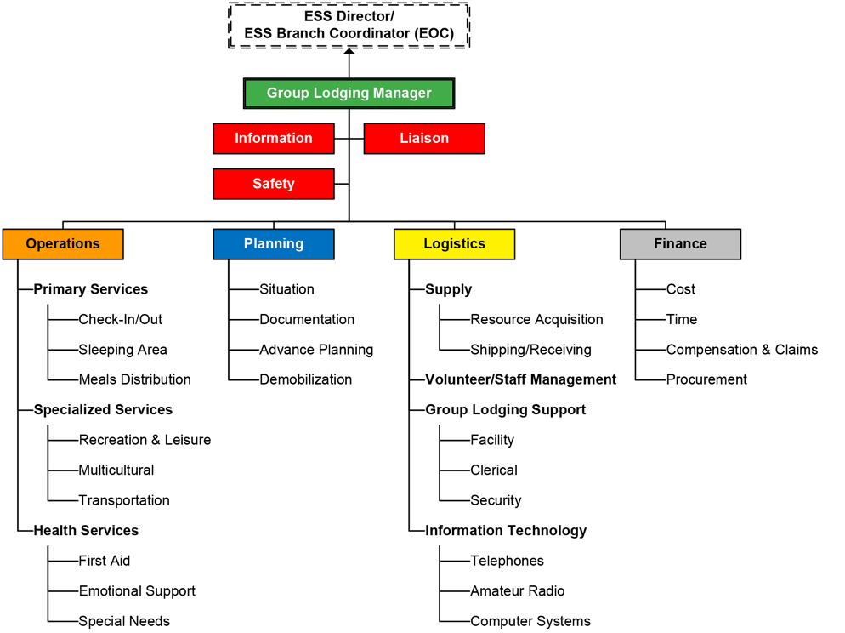
ESS Group Lodging Organization Chart
Notes:
Briefly review how ESS is applied to an organizational structure, and that the organizational structure is modular.
Modular Organization: The organizational structure is flexible and can expand or contract according to the needs of the ESS response. Resources can be activated when needed or demobilized when no longer required.

Slide 34
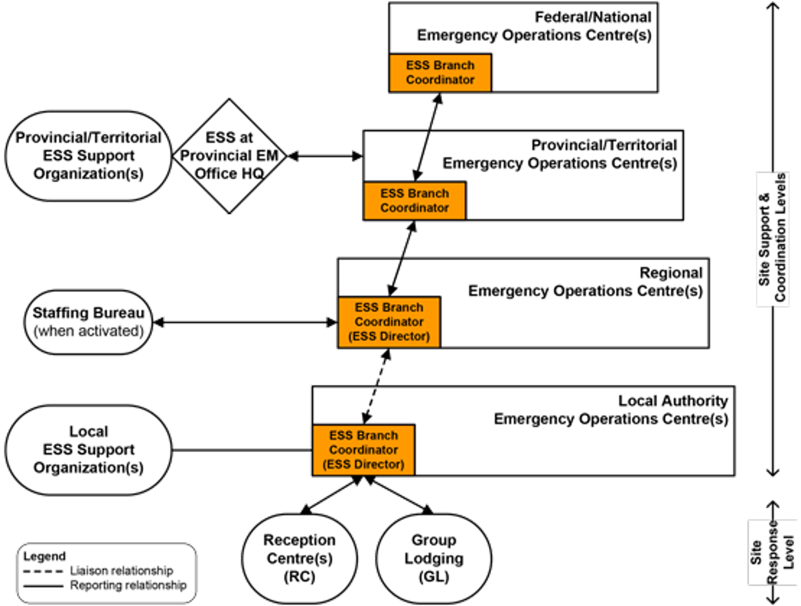
ESS Structure Multi-Level Response
Notes:
Explain the structure of an ESS response when it involves multiple levels.
In ICS, an incident command post (ICP) is the field location at which the primary command function is executed. In ESS, the ICP or site-level would be where ESS is provided to evacuees, e.g., near the incident, on a bus where evacuees are being registered for ESS. In a larger incident, the site would be the reception centre and/or the group lodging facility. When the site level requires support or guidance, emergency operations centre (EOC) site-support levels may also be activated.
In a larger response, the ESS Director would likely be located at the Local Authority EOC as the ESS Branch Coordinator within the Operations Section.

Slide 35
ESS Services
ESS provides short-term temporary services to allow those impacted by disaster so they can begin to plan their next steps.
Basic Services
Food
Clothing
Transportation
Incidentals
Shelter
Response/recovery information
Additional Services
Emotional support
Volunteer services
Pet services
Transportation services
Notes:
Review the services that ESS provides.
ESS is typically provided for a period of up to 72 hours (for those who are eligible and unable to access other resources). During this initial period, evacuees should immediately plan their next steps by contacting their insurance agents, families and friends, or accessing other possible resources and begin their transition to recover. In BC, the Emergency Management Climate Readiness Regional or ESS Office may extend ESS under exceptional circumstances on a case-by-case basis.

Slide 36
ESS Activation Levels
Level 1
A localized event that can be managed using minimal ESS resources (i.e., single house fire)
Level 2
An event that requires the full use of a First Nation Government or Local Authority’s ESS resources. A reception centre and/or emergency operation centre may be activated. (i.e., fire in an apartment complex)
Level 3
An emergency that exceeds a First Nation Government or local authority’s capacity to respond and requires assistance from neighbouring jurisdictions or the province. (i.e., interface wildfire that causes a city to evacuate)
Notes:
Review the ESS activation levels

Slide 37
ESS Support Organizations
Notes:
Briefly explain that ESS works closely with support organizations.
In BC, the ESS Office has agreements with ESS Support Organizations to provide additional resources to communities in major emergencies. Posted on the slide are some examples of agencies that are ESS Support Organizations.

Slide 38
Discuss What You’ve Learned
[Add Discussion Question(s)]
Reflect on the discussion question(s)
Discuss your responses with a small group
Share with the large group
Notes:
Activity Objective: For participants to consider the discussion questions and be able to describe the responses
Instructions:
Select 1-2 of the discussion questions below and put them on the slide
How is our ESS team structured?
What services does ESS provide? What is most typically provided by your ESS team?
On Your Own (2 minutes)
Have students consider the question
Suggest students record their thoughts on their Participant Guide
In small groups (5 minutes)
Student discuss their thoughts on the discussion question with their group
In a large group (5 minutes)
The class discusses their responses

Slide 39
Activity: ESS Response Process
In Small Groups
Work together to answer the questions about the ESS response process.
Notes:
Activity Objective: For participants to work together and increase understanding of ESS Response Process.
In Small Groups (10-15 minutes)
Work together to answer the questions about ESS Response process in the participant guide.
Debrief (5 minutes)
Take up the questions with the participants.

Slide 40
Module 3: ESS Responder Functions

Slide 41
ESS Responder Functions Summary
Rights and responsibilities of ESS responders
Public Safety Lifeline Volunteer Code of Conduct
An ESS Call Out
Using the 24-hour Clock
Reporting to Work
Differentiation of level 1, 2, 3 response structures
Debriefing
Notes:
Summary of what will be covered in Module 3.

Slide 42
ESS Responder Requirements
First Nations Government and Local Authority requirements
Provincial requirements
PSLV Code of Conduct
Rights of ESS responders
Notes:
Review the requirements of ESS responders.
The basic requirements for becoming an ESS responder varies by community. This may include things like criminal record checks, time commitments, transportations, ability to be contacted, certifications.
In BC, when carrying out EMCR’s valuable Public Safety Lifeline (PSL) services, workers’ compensation and liability coverage is provided to all volunteers. For more information on coverage, please refer to Volunteers /ESS/Volunteer Resources section.
For workers’ compensation and liability insurance purposes, the minimum age to enroll with the provincial EM office (in BC, it’s EMCR) is 16. Volunteers between 16 and 18 years of age require signed consent from their parent or guardian. There is no maximum age. In BC, a PSLV registration form must be completed and signed by the volunteer and the ESSD or designate.
ESS Responders have rights to orientation and appropriate training, a forum for input, support, safe conditions, and necessary supplies and equipment for their role wherever possible.

Slide 43
ESS Response
ESS call out
Date and time recording
Reporting to work
First-in plan
Responsibilities of all ESS responders
Responder safety
Notes:
Explain the process of an ESS response for the community.
ESS Call Out
As an example, a typical apartment fire ESS call out is initiated by contact from the fire chief to the EPC or ESSD regarding the need to provide evacuees with food, clothing, and/or lodging for a specific length of time. The ESSD is alerted and briefed on the situation. Depending on the size of the incident, the ESSD or designate would call out ESS team members to assist with the response. The ESSD would remain in command, delegating authority to the ESS team, until all evacuees are cared for.
Date and Time Recording
It is recommended that dates be usually written as YYYYMMDD.
Time recording uses the 24-hour clock and is stated as local time to account for the time zone differences in each province.
This clock is showing either 10:12 AM, known as 1012 hours, or 10:12 PM, known as 2212 hours.
Reporting to Work
Once you have been called out, there are a number of things you need to do before proceeding to the site:
Communicate with your family and employer – tell them that the ESS plan has been activated and how you will maintain contact with them
Dress casual and in layers – wear appropriate clothes for the job, season, and work
Take your grab and go bag
Take a cell phone if you have one, wall/vehicle charger, and contact lists
Bring ID – vest, hat, t-shirt, jacket, name tag, photo ID card (local and provincial or territorial)
On your way, keep clear of disaster response routes; they are for emergency vehicles and should not be used to leave the area, unless directed by emergency response personnel
First In
If you are the first ESS responder on-site (or one of the first) you will assume the role of Reception Centre Manager until a more experienced or designated management team member arrives on-site. There are a few things that you can do to get started no matter what your designated role is (your First Nations Government or Local Authority’s ESS plan will have more details specific to your community):
Responsibilities of all ESS Responders
Confirm work assignment and find out who you report to
Sign the (EMCR) Task Registration Form daily to ensure workers’ compensation and personal liability coverage; for reference, view a blank Task Registration Form.
Introduce yourself to your supervisor and other ESS responders
Set up your assigned area with required equipment, forms and stationery
Buddy up with another ESS responder to ensure their well-being
Listen for the call to the staff briefing and attend
Take the time to sit down and review the checklist for the function and/or functions you have been assigned to
Direct any questions to your supervisor
Remember worker care, take your breaks!
Responder Safety
Ensure the health and safety of responders throughout the response.

Slide 44
Level 1 Response
Notes:
Explain how a level 1 response is structured, and the functions in an ESS Level 1 response
The most common emergencies are activated at level one. Services are usually provided at or near the site of the incident and may be delivered by two ESS team members designated by the First Nations Government or Local Authority. The organization chart shows a level one ESS response structure with functions that can be activated to assist evacuees. Keep in mind that only two responders are needed for all of the functions that are activated during a level one response.

Slide 45
Level 2-3 Response
Notes:
Explain how a level 2-3 response is structured, and the ESS functions in a level 2-3 response
During level two or three responses, generally a reception centre and/or group lodging facility are activated. The organization chart show level two or three ESS response structures with functions that can be activated to assist evacuees. Keep in mind that one responder can perform more than one function, for example, if there is a medium sized response, half of the functions are activated, and seven ESS team members are called out, they can perform all the functions that are activated.

Slide 46
Discuss What You’ve Learned
[Add Discussion Question(s)]
Reflect on the discussion question(s)
Discuss your responses with a small group
Share with the large group
Notes:
Activity Objective: For participants to consider the discussion questions and be able to describe the responses
Instructions:
Select 1-2 of the discussion questions below and put them on the slide
Where can you go to reference the rights and responsibilities of ESS responders?
What are some of the rights of ESS responders?
What are you unsure about regarding the rights and responsibilities of ESS responders?
On Your Own (2 minutes)
Have students consider the question
Suggest students record their thoughts on their Participant Guide
In small groups (5 minutes)
Student discuss their thoughts on the discussion question with their group
In a large group (5 minutes)
The class discusses their responses

Slide 47
Debriefing
What went well
Lessons learned
Areas for improvement
Action plans to ensure progression
Peer support
Notes:
Go over the debriefing process for ESS.
The learnings from these sessions are important in improving the execution of future responses.

Slide 48
Activity: ESS Responder Functions
In Small Groups
Work together to answer the questions about ESS responder functions.
Notes:
Activity Objective: For participants to work together and increase understanding of Emergency Responder Functions.
In Small Groups (10-15 minutes)
Work together to answer the questions about ESS Responder Functions in the participant guide.
Debrief (5 minutes)
Take up the questions with the participants.

Slide 49
Any remaining questions about the content?
Notes:
Group Discussion: Any remaining questions about the content?
Ask the participants if they have more questions before the scenario and evaluation.

Slide 50
Quiz
Turn to Module 4 in your participant guide. Get into small groups and read the scenario. Complete the quiz with your groups, with a score of 70% or above. You can take the quiz as many times as you like.
Notes:
OPTIONAL SLIDE
Adjust this slide based on which option(s) you are selecting for course completion. Use the instructions on the slide, or replace them with one of the following options. If not using a quiz for course completion, omit this slide.
Complete the scenario and quiz in Module 4 of your participant guide, with a score of 70% or above. You can take the quiz as many times as you like.
Turn to Module 4 in your participant guide. Get into small groups and read the scenario. When you are done reading the scenario, we will discuss the quiz questions together.
To complete this course, take the quiz online with JIBC. Follow the instructions at the back of your participant guide.
The quiz can be completed as a large group, in small groups, individually or online. The online course may take a few hours to register, so if choosing this option, we recommend students register before the course session or you ask them to complete it on their own within a few days of the course ending.
See the Course Materials Guide and ESS Course Completion Guide for details on Course Completion.

Slide 51
Closing Activity
What is one thing you understand well after the course?
What is one thing you want to learn more about?
Notes:
Activity Objective: For participants to learn about the strengths of their peers, and to self-reflect on their learning
Optional Group Discussion: Go around the class and ask the students to name one thing they learned well, and one thing they want to learn more about.

Slide 52
Course Completion Forms
To have course completion recorded by JIBC:
Fill out the ESS Course Completion Form and Student Information Form* in your Participant Guide and return it to your facilitator.
After JIBC enters the information into the student records system, the paper copies will be destroyed.
*You only need to fill out the Student Information Form if you don’t have a JIBC student number
Notes:
Note for All Facilitators
This Student Information Form and ESS Course Completion Form is required by all students in order to have course completion recorded on their JIBC student transcript.
If students do not complete all the information on this form, the course completion may not be recorded.
These forms are in the back of the manuals. Instruct the students to rip out the forms and provide them to the facilitator. The facilitator must provide the forms to the ESSD, EPC, or designate to be sent to JIBC.
Do not photocopy these forms. Photocopied forms may not be accepted.

Slide 53
Thank you!
Information about the JIBC ESS Training Program
Website: jibc.ca/ess
Email: ess@jibc.ca
Notes:
Note to Community Facilitators
This is an optional slide for community facilitators.
If you wish to add or modify the information on this slide, please do so as you wish. You are not obligated to further promote JIBC courses, but it is recommended as this is where the ESS program is developed and administered.

