Slide 1
EMRG-1607
Level One ESS

Slide 2
We respectfully acknowledge the Justice Institute of British Columbia’s New Westminster campus is located on the unceded Traditional Territories of the qiqéyt (Qayqayt), xʷməθkʷəy̓əm (Musqueam) and Coast Salish people.
Notes:
Note to All Facilitators
We recommend including a land acknowledgement at the start of your presentation, or open the course in a good way. Your community or ESS team may already have a way they prefer to do this.
You can use the same format on the slide – change the location and the names of the territories for which you reside. You may also want to include actions that you, or your ESS team do to move towards reconciliation.
If you are unsure of the territories on which you reside, please visit https://native-land.ca/.

Slide 3






Housekeeping
Emergency Exits
Washrooms
Phone Use
Breaks
Materials
Notes:
Note to All Facilitators
Cover these items with the information specific to your training location. Materials is the only item that will not change based on the training location.
Below is a template for how we recommend discussing these items:
Emergency Exits:
Direct people to where the emergency exits are
Washrooms:
Direct people to where the washrooms are
Phone Use:
Please do not use your phone during the session.
If you must take an urgent call or respond to an email, please leave the training room to do so and return when you are done.
Breaks:
There is one scheduled 15-minute break during this session <insert the time>
Please feel free to leave the training room at any time if you need a break before this time
Paperwork:
You should have an EMRG-1607 participant guide. This contains the content that we will be covering during this course as well as the activities we will be doing throughout the session.
There is a student information form at the back of the manual that you will complete and return to the facilitator at the end of the session.

Slide 4
Instructor Introductions
Instructor Name Here
Instructor Name Here
Information about instructor.
Information about instructor.
Notes:
Instructor Introductions (5 minutes)
Insert your introductions here.

Slide 5
Icebreaker Question
Notes:
Activity Objective: A quick icebreaker question to get students familiar with one another. Introductions should take between 30-60 seconds per participant.
Instructors are expected to keep the icebreaker section within the time specified in the lesson plan. Instructors should provide reminders to participants to keep their responses short if they are consistently taking longer than expected
Full Group Discussion (15 Minutes)
Select from one of the same icebreaker questions below:
Share your name and name of team
Share your name and how many years of experience you have in <field>
Share your name and the last role you had during a response/call-out

Slide 6
Learning Outcomes
Upon completion of this course, you will be able to:
Define a Level One ESS response
Describe the steps taken in a Level One response
Describe the tools included in a Level One response "kit"
Complete the required paperwork for a Level One response
Discuss how a Level One ESS response differs from the other levels of ESS activation
Practice "worker care" principles
Address the emotional support needs of evacuees
Notes:
Review the learning objectives.

Slide 7
Level One ESS

Slide 8
Emergency Support Services (ESS)
Emergency Support Services (ESS) provides short-term
basic support to people impacted by disasters.
The program is financed by the provincial government and administered by Indigenous communities and local governments.
ESS is designed to provide short-term support following disasters ranging from a single house fire to provincial level events involving large evacuations. These supports enable people to re-establish themselves as quickly as possible after an emergency or disaster.
Notes:
Provide a concise description of ESS.

Slide 9
Emergency Support Services (ESS)
Services Include
Registration
Emotional support
Family reunification
Supports (food, shelter, clothing, incidentals, etc.)
Notes:
Describe the services that ESS provides

Slide 10
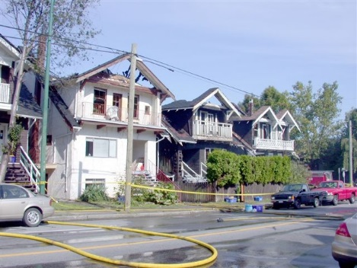
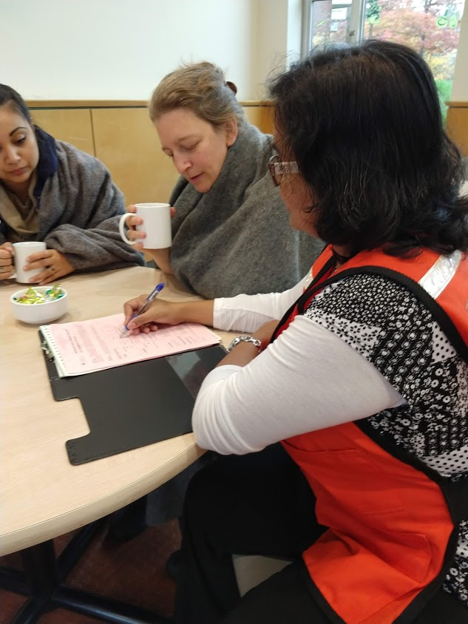
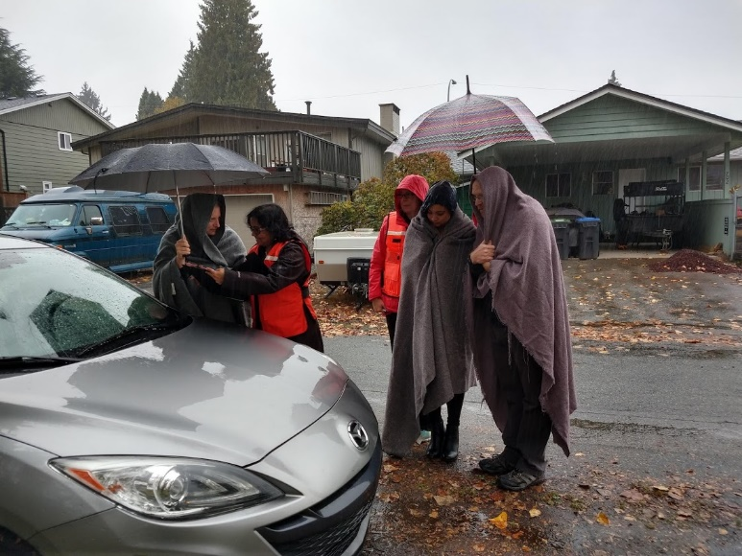
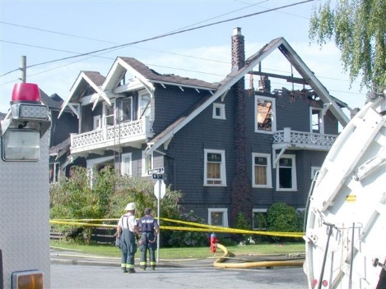
The Need for ESS
Notes:
This slide should present the circumstances where an ESS response is typical, using multiple examples. Following this, the instructor can explain how a community would be set up for that response..
ESS has a vital role in
Assisting people to remain independent and self-sufficient
Assisting people to meet basic needs
Providing accurate and current information
Assisting people to re-establish themselves as soon as possible

Slide 11
Level One ESS
A small-scale Emergency Support Services event:
Involving 12 or fewer people
Home are made uninhabitable as a result of an emergency or disaster
Does not require the activation of a Reception Centre
Notes:
Level 1 involves the evacuation of only one or two families (or up to 12 people), without activation of a Reception Centre. Services are usually provided at or near the site of the incident and may be delivered by members of the ESS team or other agencies designated by the local authority. A Level One ESS response is frequently activated by local fire or police dispatch and generally requires only two ESS responders. This is the most common level of ESS response.
Discuss both descriptions of ESS at Level 1 and limitations
Sometimes known as “On the street” ESS
Not to the level of implementing a Reception Centre
Provide helpful examples to set scene for ESS activations.
Clarify the parameters of a Level 1 ESS response.

Slide 12
Determining Eligibility
The principal residence, which they own or rent, is uninhabitable due to a fire, flood, chemical spill, or similar emergency
The household does not have or cannot immediately access insurance to cover the loss
Notes:
Households are eligible if their principal residence, which they own or rent, is uninhabitable due to a fire, flood, chemical spill, or similar emergency and t he family does not have or cannot immediately access insurance to cover the loss.
If the family does have insurance, lodging, food and clothing are likely paid for by their insurance company and the family should immediately contact their insurance agent. If they have difficulty doing so, or are uncertain about their coverage, call EMCR ECC staff at 1-800-663-3456 and request approval to provide services, pending clarification of insurance.
Service is offered only for the 72 hours immediately following the loss of residence. If for some reason Level One ESS volunteers are not notified until after the 72-hour period has ended, and if the family is still in need, refer them to other community agencies.

Slide 13
Determining Eligibility
If you have any questions about eligibility, contact EMCR at 1800-663-3456 for guidance
ESS Service is only provided for the 72 hours immediately following the loss of residence
Notes:
Review the parameters for ESS and where Level One responders can go for assistance.

Slide 14
Discuss What You’ve Learned
[Add Discussion Question(s)]
Reflect on the discussion question(s)
Discuss your responses with a small group
Share with the large group
Notes:
Activity Objective: For participants to consider the discussion questions and be able to describe the responses
Instructions:
Select 1-2 of the discussion questions below and put them on the slide
What are some examples of Level one ESS response?
Which are the most common that are responded to by this ESS team?
On Your Own (2 minutes)
Have students consider the question
Suggest students record their thoughts on their Participant Guide
In small groups (5 minutes)
Student discuss their thoughts on the discussion question with their group
In a large group (5 minutes)
The class discusses their responses

Slide 15

Getting Ready with BCEMS
RESPONSE, PROVIDING SERVICE
PLANNING, PREPARATION,
ORGANIZATION, ACTIVATION PROCEDURES
BC EMERGENCY MANAGEMENT SYSTEM (BCEMS)
Notes:
The Province of British Columbia has adopted an Emergency Response Management System to ensure a coordinated and organized response to all emergency events. Responses are like an iceberg, you often will only see the response and providing service, but there is a lot of organization and planning occurring beneath the surface.
Provincially, ESS is modeled on the BC Emergency Management System (BCEMS). This system is designed to easily expand or contract, depending on the size and complexity of the emergency.

Slide 16
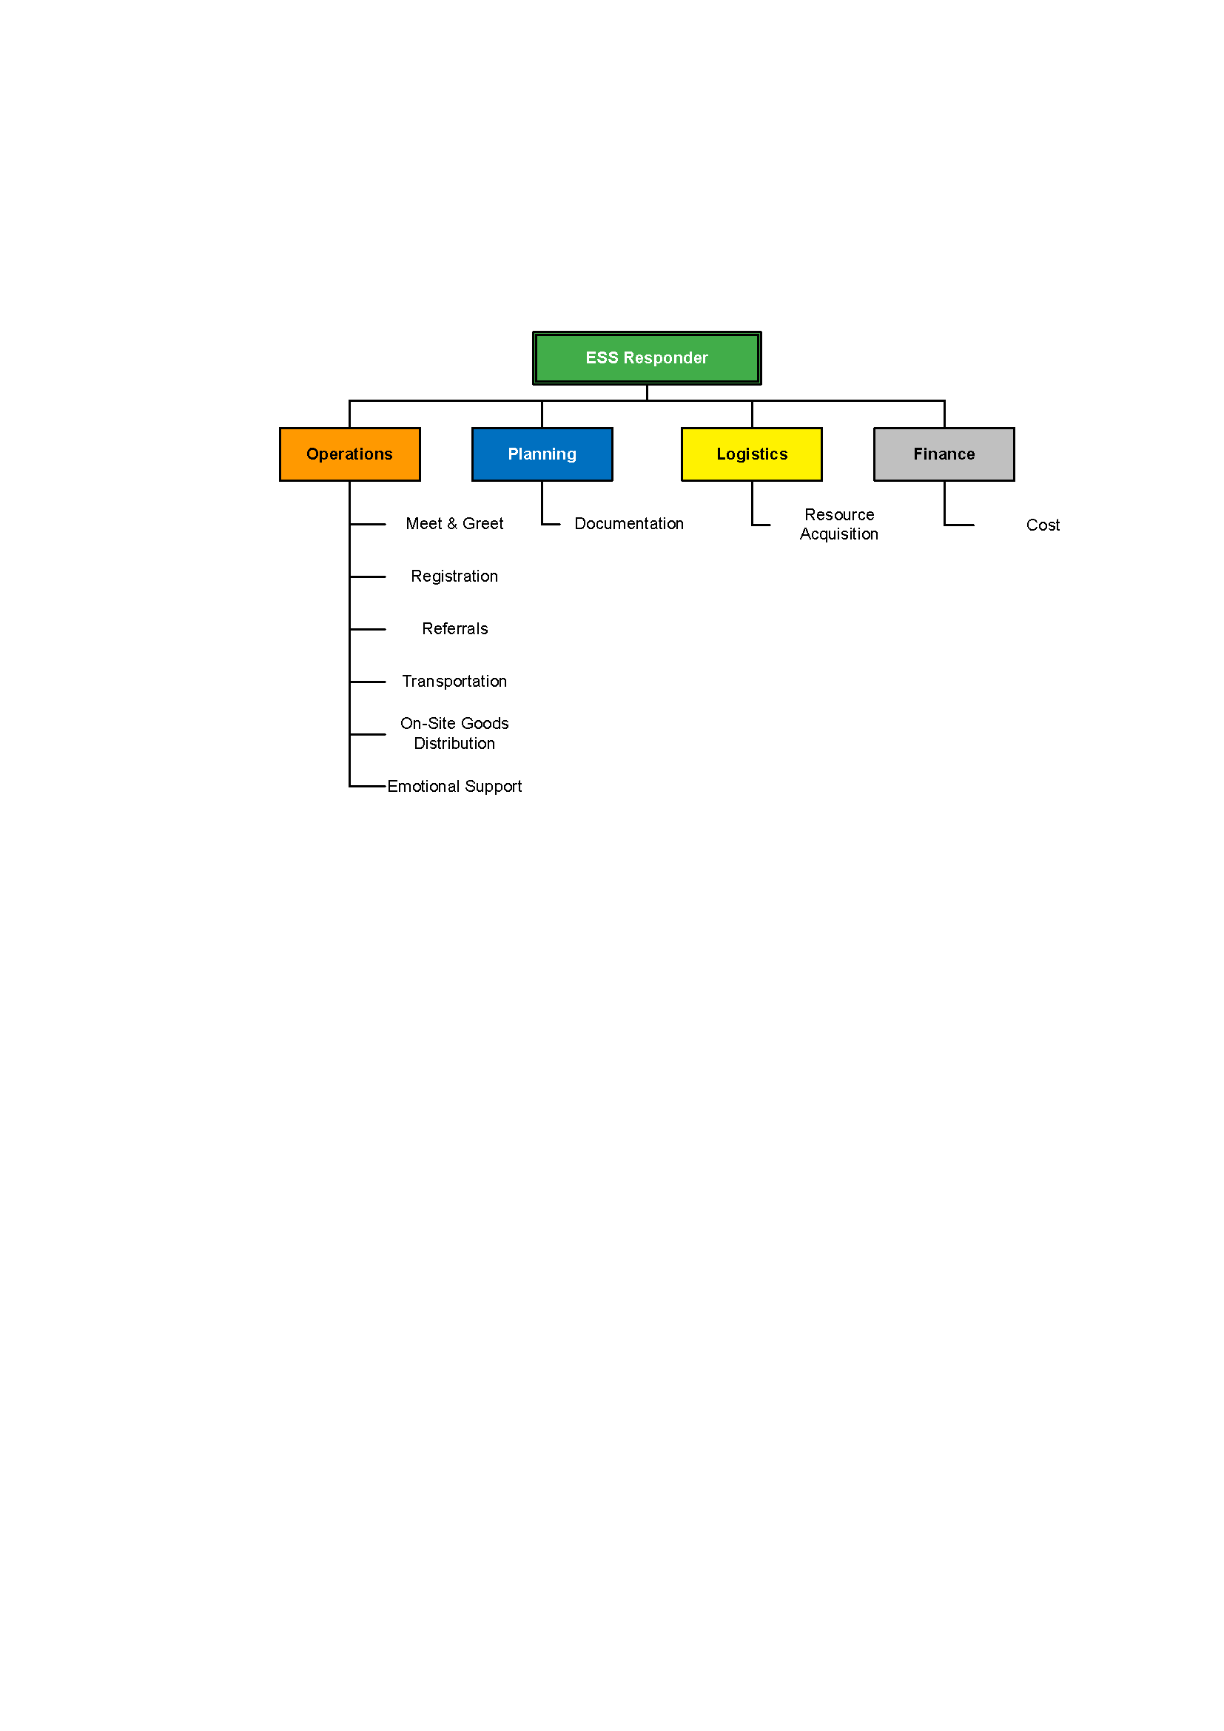
ESS Level 1 Response
Notes:
Even a Level One ESS response can operate under this BCEMS. The above sample scenario illustrates the activation of the functions required for an effective response. Because of the small size of a Level One event, two volunteers may fulfill all the required functions (noted in parentheses).
Use a community example, or the example below, to illustrate the activation if the functions required for an effective response.
Fire department contacts Level One ESS volunteers to assist the family whose home has burned.
One of the volunteers contacts EMCR to get a task number for the event (Cost Unit).
The volunteers travel to the family (Meet & Greet Unit).
The volunteers give each family member a blanket and each child a teddy bear (On-Site Goods Distribution Unit).
The volunteers inquire about the family’s immediate needs and provide a “listening ear” and reassurance (Emotional Support Unit).
If the family has no other alternatives to meet their immediate needs, the volunteers contact ESS suppliers to confirm their availability to assist the family (Resource Acquisition Unit).
Upon confirmation from suppliers, the volunteers complete the required Referral forms and brief the family on the services they will be receiving (Referrals for Food, Clothing and Lodging Unit).
The volunteers ensure that the family is transported to their assigned lodging if required (Transportation Unit).
The volunteers send the completed paperwork to the designated authority for processing (Documentation Unit).

Slide 17
EMCR Provides…
ESS training
24-hour phone support
Financial support
  Lodging or shelter allowance, food, clothing, transportation, incidentals
Notes:
The Ministry of Emergency Management and Climate Readiness (EMCR) assists communities in building this capacity by offering training and 24-hour phone support for Level One ESS response. EMCR also reimburses suppliers for approved costs for lodging, food, clothing and other goods and services provided, according to established policies and procedures.

Slide 18
Who is Responsible?
Local ESS team
Municipal employees
Contract or partner organizations (e.g. Red Cross, Victim Services).
Notes:
As legislated by the provincial Emergency Program Act, the local authority is responsible for the preparation for, response to, and recovery from, disasters. This responsibility includes determining how best to respond to Level One ESS responses within their jurisdiction.
The local authority may choose to use a local Emergency Support Services team, engage municipal employees, contract or partner with an organization like the Red Cross, Victim Services or The Salvation Army, or implement another method of providing Level One ESS response for their community.

Slide 19
Advance Preparations for ESS Level One Responders
Meet the Level One
ESS Team
Meeting with Emergency Program Coordinator & ESS Director
Able to complete supplier consent forms
Attain list of Community Resources
Inform Family and Employers of team involvement
Notes:
Emphasize that within an organized system, it is now possible for municipalities and volunteers to prepare themselves in advance for a call out.
Review the steps taken to prepare ESS volunteers for duty.
Consider brainstorming what Community Resources they could add to their list.
Step One: Meeting the Level One ESS Team
Team members should meet to exchange relevant information, including work and home phone numbers and vacation schedules. Review this manual to ensure that you share the same understanding of Level One ESS procedures.
Step Two: Meeting with the Emergency Program Coordinator & ESS Director
Your community’s Emergency Program Coordinator and Emergency Support Services (ESS) Director should also meet with the team. The Emergency Program Coordinator is responsible for overall coordination of disaster response in your community. The ESS Director oversees human services such as feeding, clothing, lodging, counselling, and family reunification after a disaster.
Step Three Completing Supplier Consent Form
If you find you need to sign up a new supplier, you will need to complete a Supplier Consent form with them. Give the supplier an opportunity to read the ESS Rates sheet and the Supplier Procedures Sheet, and be prepared to answer questions.
Step Four: Community Resources for Referrals
After three days of assistance, some families need additional support before they can again become self-supporting. Your Level One ESS team can help by providing a Community Resources list to distribute as needed. The community ESS Director may be able to provide this list or assist in developing one.
Step Five: Family and Employer
Enlist the cooperation of your family and employer by letting them know about your Level One ESS responsibilities, so that when you are called out, they will know what to expect.

Slide 20
Call Out Procedures
Incident Occurs
Police/Fire/Dispatch contact EPC/ESSD or Designate
EPC/ESSD contact EMBC for a task # to authorize ESS expenses
Level One Call out by EPC/ESSD
A minimum of two responders attend the call
Take your kit
Obey laws and drive safely
Identify yourself to person in charge
ESS in action!
Notes:
Review what a call out can look like for a Level One ESS response, run through a call out from a past response or use the description below.
Discuss alternatives or variations on this procedure.
When a family is forced from its home and has no alternate accommodation, the fire or police department calls the Emergency Program Coordinator or the person designated by the Emergency Program Coordinator as the contact person.
The Emergency Program Coordinator (or designate) calls EMCR in Victoria at 1-800-663-3456 and obtains a task number authorizing expenditures. When estimating the cost of an incident use $400 for one adult and $250 for each additional family member.
The Emergency Program Coordinator (or designate) calls an ESS Level One responder.
The responder calls a second Level One ESS team member and, working together, they go to meet with the evacuees immediately.
When you leave home, bring your response “kit,” which should include a folder containing this manual, an Action Checklist and the forms and brochures listed on the Action Checklist. If you have additional supplies available, such as blankets, comfort kits or teddy bears, these should also be included with your response kit.
Although it is important to offer assistance as soon as possible, drive carefully and observe the speed limit and road conditions.
When you arrive at the site of the incident, immediately identify yourself to the officer in charge, who may be either a police officer or a firefighter. Ask if there are dangerous areas you should avoid or other personal safety issues.

Slide 21
Discuss What You’ve Learned
[Add Discussion Question(s)]
Reflect on the discussion question(s)
Discuss your responses with a small group
Share with the large group
Notes:
Activity Objective: For participants to consider the discussion questions and be able to describe the responses
Instructions:
Select 1-2 of the discussion questions below and put them on the slide
What are the first steps to do when receiving a call out for a level one response?
What are the first steps when arriving to the scene of a level one response?
What are some items to include in your level one response kit?
What is an item included in a level one response kit that you did not expect?
On Your Own (2 minutes)
Have students consider the question
Suggest students record their thoughts on their Participant Guide
In small groups (5 minutes)
Student discuss their thoughts on the discussion question with their group
In a large group (5 minutes)
The class discusses their responses

Slide 22
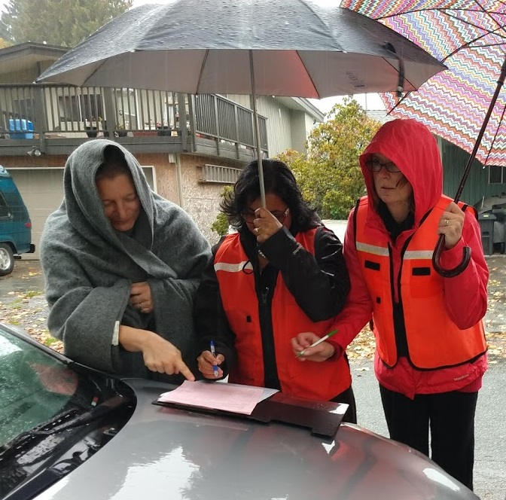
Providing Service
Level One Response
Notes:
Discuss the nature of providing service:
Ask participants what might be expected of ESS responders arriving on site.
Encourage participants to identify ESS actions in ICS terms so that they can be defined in the org chart. For example, even something like giving family members a blanket can be understood in these terms.
Review org chart definitions to clarify:
• many of the frontline actions are considered Ops functions;
• however, the planning, logistics, finance support the frontline actions.

Slide 23
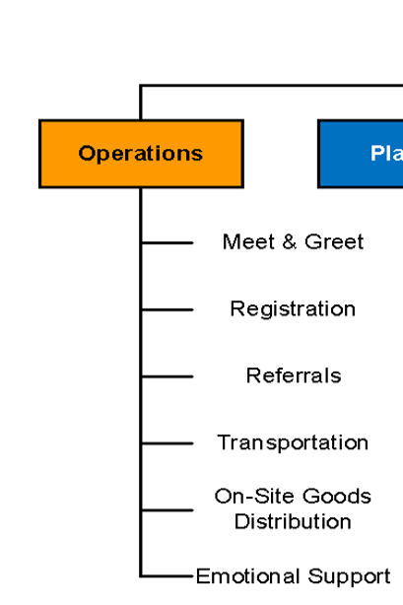
Providing Service
ESS Referral Forms are provided for each supplier (Operations)
Where possible accompany evacuees to the supplier (Operations)
Remind suppliers about the billing process (Logistics)
Provide evacuees with a community resource list (Operations)
Check in with evacuees to point them in the right direction and provide emotional support (Operations)
Notes:
Discuss how each of these tasks relates to different responder functions.
Discuss which of these tasks may be expected in a Level One ESS response in this community.

Slide 24
Break
15 Minute Break

Slide 25
Donations: Money and Goods
ESS responders cannot accept monetary donations for evacuees
Appealing for clothing or furniture donations is not a Level One ESS responsibility.
A community organization, Go Fund Me website, or local financial institutions are possible options.
Notes:
Consider the appropriate ESS response to the offer of donations.
Review the PP slide to distinguish what is appropriate and what is not appropriate for donations of money/supplies.

Slide 26
News Media
You arrive on an ESS call to a family whose house has been damaged and is determined to be unlivable.
There are some first responders on the scene; a fire truck is nearby. There are bystanders gathered around the perimeter of the scene. A police officer is asking people to stand back.
You and another ESS volunteer are sitting near the house, filling out a referral form when you notice a CTV van pull up.
A camera operator and a reporter get out and begin to head towards you and the family
Notes:
Group Discussion:
Read the scenario and then discuss the following questions:
What kind of questions would you expect to hear?
How would you respond?

Slide 27
News Media
Have an approved statement
Never Speak
“Off the Record”
Contact your immediate supervisor or ESSD if you have questions about media
Never make statements that involve privacy or speculation.
Be cooperative, but if pressed for information refer media to the on-site Incident Commander
Notes:
Ideally, your supervisor will give you a contact name for any inquiries received from the media during a response. If the organization you represent requires that you be prepared to talk to the media, you should request detailed instruction in regards to their expectations. Inexperienced or untrained personnel should not be assigned to work with the media.
Tips for Dealing with Media
If you have not received any direction from your supervisor and are approached by the media, the most appropriate statement for you to make is simple and general, for instance: “Level One ESS provides assistance with accommodation, food and other essentials, as needed, during the 72 hours following a family’s loss of residence.”
If you are uncertain about how to proceed with the news media on a sensitive subject, phone your ESS Director or your immediate supervisor.
When talking to a reporter, keep your answers clear, short and accurate.
Never speak “off the record.”
Remember that you are representing the local authority as well as your organization when speaking to the media. What you say can influence people’s perception about either organization, so it is important to speak positively.
Be cooperative with the media, but do not answer any inappropriate questions. If you are pressed for more information than you are authorized to provide, refer media to the on-site Incident Commander (usually a police officer or firefighter).
Certain kinds of statements are never made to the news media:
Privacy: Details of assistance are not provided to the media, since this would constitute an invasion of the evacuee’s privacy. Under no circumstance should an ESS responder provide any of the evacuee’s personal identifying information, including the name of the hotel at which they are staying. Confidentiality is a key ESS policy. An acceptable statement is: “We provided accommodation and support to the family.”
Speculation: Questions about the nature and the cause of the incident are referred to the fire or police department, since they are in a position to give accurate information based on their investigation. For example, the question “Many people are saying that this flood would not have happened if the government had released water from the dam earlier in the spring—what do you think?” is best answered by “We’re just here to help the family—you will have to ask others about that.” That sounds better than a blunt “no comment,” but it amounts to the same thing.

Slide 28
Follow-Up
Evacuee Referral
Action Checklists
Task Registration Form
EMCR Task Report
Volunteer Reimbursement
Reflect on Learning
Notes:
Review follow-up activities.
Discuss the importance of each of these follow-up activities.
Referrals
Prompt, accurate completion of paperwork is essential to the Level One ESS program as it ensures merchants are paid promptly.
Action Checklists
Deliver a copy of your completed Action Checklist to your supervisor.
EMCR Task Registration Form
Each time you respond to an event you are required to sign a EMCR Task Registration Form in order to ensure your eligibility for WCB coverage and liability insurance.
EMCR Task Report
You or your supervisor will complete a EMCR Task Report once a Level One response is complete. The Task Report allows the EMCR Regional Office to stay informed of response activities and provides a record of events to match with expense claims. Forms can be found on the EMCR website.
Volunteer Reimbursement
If you incur travel or meal costs while on a Level One ESS response and are not reimbursed through your response organization, you may request reimbursement from EMCR by completing an Expense Reimbursement Request
Reflect on Learning
Each time you give service, take the opportunity to learn for the future. Discuss what you learned with your supervisor and Level One ESS team-mates, highlighting your successes and noting improvements you intend to make.

Slide 29
Discuss What You’ve Learned
[Add Discussion Question(s)]
Reflect on the discussion question(s)
Discuss your responses with a small group
Share with the large group
Notes:
Activity Objective: For participants to consider the discussion questions and be able to describe the responses
Instructions:
Select 1-2 of the discussion questions below and put them on the slide
Where can you find the required paperwork for a Level One response?
How can you practice the paperwork for a Level One response?
On Your Own (2 minutes)
Have students consider the question
Suggest students record their thoughts on their Participant Guide
In small groups (5 minutes)
Student discuss their thoughts on the discussion question with their group
In a large group (5 minutes)
The class discusses their responses

Slide 30
Interacting with Evacuees

Slide 31
What feelings and thoughts might evacuees have at a Level One response?
What should you consider when interacting with evacuees?
Notes:
Purpose (share with group): To consider the experience of evacuees.
Considerations: People differ in what they need in moments of distress. What works for you may not work for another person.

Slide 32

Notes:
https://www.youtube.com/watch?v=c_wOnJJEfxE&pp=ygUid2hhdCBpcyBjdWx0dXJhbCBodW1pbGl0eSBwc3ljaGh1Yg%3D%3D

Slide 33
Why is it important to consider Cultural Humility when working with evacuees?
Notes:
A: You may be working with people from cultures that you are unfamiliar with, it is important to respect that their experience and understanding of things may be different from your own.
For example: You may prefer a specific restaurant or hotel, but an evacuee may have different cultural factors to consider when making those choices.

Slide 34
W
A
D
E
Wait for Evacuees’ Responses
Give evacuees time to process answers
Respect silence
Ask What Evacuees Need
When possible, give evacuees options
Ask how you can assist
Don’t Assume
Do not assume: support needs, socioeconomics, identity, gender, or accessibility needs
Evacuee-Centered
Supporting the evacuee is at the centre of the work
Self/worker-care is evacuee care
Notes:
WADE is a framework that outlines suggested practices for working with evacuees.
This is important to consider within the frame of cultural humility, and in being sensitive to evacuees who have gone through a difficult experience.
Students also have been given a tipsheet that outlines WADE. Highlight this for them as well.
WADE
W – wait for evacuee responses
There are many reasons evacuees may benefit from time to process answers
Leave silence for them to think and answer
A – Ask what evacuee’s need
It is better to give options as opposed to assume, but example “which grocery story will be better for you”
If you notice someone needs assistance, it is better to ask if they need help and how, as opposed to jumping in to do something
D – don’t assume
Do not assume what kind of support people need (this related to the above, ask them what they need instead)
Do not assume someone’s identity and what support they may need based on the perceived identity
For example, someone may be dressed well, but are in need of support. It is not for the responder to judge or assume.
E - Evacuee-Centred
Supporting the evacuee is central to ESS
Focus on what the evacuee needs
If you aren’t sure how to support an evacuee, speak to a supervisor, another organization may be able to provide supports
All information is about the evacuee and they should be able to see what you are writing
Supervisors can also help come up with creative solutions
It is important to take care of yourself, if you are tired, or hungry, or frustrated, you won’t provide good care. Think about when you are being helped, you can tell when the other person is frustrated
Look out for yourself and one another, and accept when others are looking out for you

Slide 35
Discuss What You’ve Learned
[Add Discussion Question(s)]
Reflect on the discussion question(s)
Discuss your responses with a small group
Share with the large group
Notes:
Activity Objective: For participants to consider the discussion questions and be able to describe the responses
Instructions:
Select 1-2 of the discussion questions below and put them on the slide
What is one way to address the emotional support needs of evacuees?
Who can you go to for support in addressing the emotional support needs of evacuees?
Is there an aspect for the WADE framework that can be helpful in providing emotional support?
On Your Own (2 minutes)
Have students consider the question
Suggest students record their thoughts on their Participant Guide
In small groups (5 minutes)
Student discuss their thoughts on the discussion question with their group
In a large group (5 minutes)
The class discusses their responses

Slide 36
Worker Self-Care
It’s normal to be affected by a call-out
  Talk to your partner after every call to debrief informally
  Talk to you supervisor immediately for debriefing after an incident involving a fatality
Safety of ESS Responders is the top priority
  Assess your readiness to respond
  Confirm you have a partner
  Dress appropriately
  Obey laws
  Never put yourself in an unsafe situation
Notes:
Define worker seslf-care care. Or elicit definitions from the class.
Ask participants to provide examples of worker care in practice.
Emphasize the importance of worker care as an ongoing concern for ESS volunteers.
Remind participants of the ESS Response Goals to show where worker care fits.
Provide appropriate examples as needed.

Slide 37
Discuss What You’ve Learned
[Add Discussion Question(s)]
Reflect on the discussion question(s)
Discuss your responses with a small group
Share with the large group
Notes:
Activity Objective: For participants to consider the discussion questions and be able to describe the responses
Instructions:
Select 1-2 of the discussion questions below and put them on the slide
What is a worker care principle practice you would like to try?
What are worker care principles practice that you know might work well for you?
On Your Own (2 minutes)
Have students consider the question
Suggest students record their thoughts on their Participant Guide
In small groups (5 minutes)
Student discuss their thoughts on the discussion question with their group
In a large group (5 minutes)
The class discusses their responses

Slide 38
What does a Level One Responder do?
Discuss what is important for ESS volunteers in terms of:
Responsibilities
Skills Required
Training Required
Notes:
Activity Objective: For participants to review and reflect on what they have learned
In Small Groups(10 minutes)
Discuss what is important for ESS volunteers in terms of:
Responsibilities
Skills Required
Training Required
Debrief (5 minutes)
What did groups discuss?

Slide 39
Activity: Exercise Questions
In Small Groups
Work together to answer the questions about the ESS response process in the Exercises section of the participant guide.
Notes:
Activity Objective: To begin to consider several ESS Level One scenarios and situations
In Small Groups or Pairs (10 minutes)
Work together to answer the questions about the ESS response process in the Exercises section of the participant guide.
Debrief (5 minutes)
Discuss the responses to the questions
Notes
Additional notes to the instructor(s) go here.

Slide 40
Any remaining questions about the content?
Notes:
Group Discussion: Any remaining questions about the content?

Slide 41
Quiz
Get into small groups. Turn to the Course Completion section of your Participant Guide. Complete the quiz with your groups, with a score of 70% or above. You can take the quiz as many times as you like.
Notes:
OPTIONAL SLIDE
Adjust this slide based on which option(s) you are selecting for course completion. Use the instructions on the slide, or replace them with one of the following options. If not using a quiz for course completion, omit this slide.
Complete the quiz in the Course Completion section of your Participant Guide, with a score of 70% or above. You can take the quiz as many times as you like.
Turn to Course Completion section in your Participant Guide, we will discuss the quiz questions together.
To complete this course, take the quiz online with JIBC. Follow the instructions at the back of your Participant Guide.
The quiz can be completed as a large group, in small groups, individually or online. The online course may take a few hours to register, so if choosing this option, we recommend students register before the course session or you ask them to complete it on their own within a few days of the course ending.
See the Course Materials Guide and ESS Course Completion Guide for details on Course Completion.

Slide 42
Closing Activity
What is one thing you understand well after the course?
What is one thing you want to learn more about?
Notes:
Activity Objective: For participants to learn about the strengths of their peers, and to self-reflect on their learning
Optional Group Discussion: Go around the class and ask the students to name one thing they learned well, and one thing they want to learn more about.

Slide 43
Course Completion Forms
To have course completion recorded by JIBC:
Fill out the ESS Course Completion Form and Student Information Form* in your Participant Guide and return it to your facilitator.
After JIBC enters the information into the student records system, the paper copies will be destroyed.
*You only need to fill out the Student Information Form if you don’t have a JIBC student number
Notes:
Note for All Facilitators
This Student Information Form and ESS Course Completion Form is required by all students in order to have course completion recorded on their JIBC student transcript.
If students do not complete all the information on this form, the course completion may not be recorded.
These forms are in the back of the manuals. Instruct the students to rip out the forms and provide them to the facilitator. The facilitator must provide the forms to the ESSD, EPC, or designate to be sent to JIBC.
Do not photocopy these forms. Photocopied forms may not be accepted.

Slide 44
Thank you!
Information about the JIBC ESS Training Program
Website: jibc.ca/ess
Email: ess@jibc.ca
Notes:
Note to Community Facilitators
This is an optional slide for community facilitators.
If you wish to add or modify the information on this slide, please do so as you wish. You are not obligated to further promote JIBC courses, but it is recommended as this is where the ESS program is developed and administered.

