Slide 1
EMRG-1612
Introduction to Group Lodging

Slide 2
We respectfully acknowledge the Justice Institute of British Columbia’s New Westminster campus is located on the unceded Traditional Territories of the qiqéyt (Qayqayt), xʷməθkʷəy̓əm (Musqueam) and Coast Salish people.
Notes:
We recommend including a land acknowledgement at the start of your presentation, or open the course in a good way. Your community or ESS team may already have a way they prefer to do this.
You can use the same format on the slide – change the location and the names of the territories for which you reside. You may also want to include actions that you, or your ESS team do to move towards reconciliation.
If you are unsure of the territories on which you reside, please visit https://native-land.ca/.

Slide 3






Housekeeping
Emergency Exits
Washrooms
Phone Use
Breaks
Materials
Notes:
Note to All Facilitators
Cover these items with the information specific to your training location. Materials is the only item that will not change based on the training location.
Below is a template for how we recommend discussing these items:
Emergency Exits:
Direct people to where the emergency exits are
Washrooms:
Direct people to where the washrooms are
Phone Use:
Please do not use your phone during the session.
If you must take an urgent call or respond to an email, please leave the training room to do so and return when you are done.
For courses using the JIBC feedback form: Your phone will be required at the end of the session to complete the feedback form
Breaks:
There is one scheduled 15-minute break during this session <insert the time>
Please feel free to leave the training room at any time if you need a break before this time
Paperwork:
You should have an EMRG-1600 manual. This manual contains the content that we will be covering during this course as well as the activities we will be doing throughout the session.
There is a student information form at the back of the manual that you will complete and return to the facilitator at the end of the session. This required to receive a record of completion for the course.

Slide 4
Instructor Introductions
Instructor Name Here
Instructor Name Here
Information about instructor.
Information about instructor.
Notes:
Instructor Introductions (5 minutes)
Insert your introductions here.

Slide 5
Icebreaker Question
Notes:
Activity Objective: A quick icebreaker question to get students familiar with one another. Introductions should take between 30-60 seconds per participant.
Instructors are expected to keep the icebreaker section within the time specified in the lesson plan. Instructors should provide reminders to participants to keep their responses short if they are consistently taking longer than expected
Full Group Discussion (15 Minutes)
Select from one of the same icebreaker questions below:
Share your name and name of team
Share your name and how many years of experience you have in <field>
Share your name and the last role you had during a response/call-out

Slide 6
Learning Outcomes
Upon completion of this course, you will be able to:
Describe the services provided in group lodging
Explain the roles and responsibilities of the functions in group lodging
Outline how to set-up and work in group lodging
Notes:
Describe to the participants the learning outcomes, which is what they will be able to do after completing this course.

Slide 7
Module 1:
Preparing to be an ESS Responder

Slide 8
What is group lodging?
Notes:
Module 1: Group Lodging Services
Ask: What is group lodging?
GL facilities are public facilities (e.g., community centres, arenas, etc.) that are not normally used for living purposes, but have been adapted to provide shelter style accommodations for large numbers of people who have been displaced from their homes as a result of an emergency or disaster.
in GL, people will be provided with a sleeping space, meals, as well as information about the emergency
the GL facilities may have been predetermined by the ESS team in the planning phase. This section will talk about the types of services provided at a GL
Other Names for Group Lodging
Congregate lodging
Evacuation centres
Disaster or emergency relief centres
Emergency shelters (thought the term shelter has several connotations, e.g., women’s shelter, nuclear shelters, etc.)
Emergency accommodations
Emergency housing
Describe the types of services provided at a GL facility

Slide 9
What would you like to see in place at a group lodging facility that would ease your concerns about staying there?
Notes:
Ask: What would you, as an evacuee, like to see in place at GL that would ease your concerns about staying there?
Signage
Security
Check in/out, sign in/out
Information
Area(s) to sleep
Refreshments
Health care – physical, emotional support
Volunteer/staff management
Safety
Special needs
Meals distribution
Multicultural

Slide 10
About Group Lodging
Services provided at a group lodging facility depend on the circumstance
Group lodging is usually opened during a level 3 response (multiple dwellings involved)
Notes:
About Group Lodging
Not all services may be provided; some may be provided at another centre
e.g., in the Kamloops fires 2003, Resource Acquisition and Volunteer Management were done at a separate facility that managed resources for 2 RCs and 1 GL so critical resources could be prioritized
Generally, pets are not allowed in GL due to allergies and health regulations, with the exception of registered assistance animals. Some local authorities have access to larger facilities and may allow pets in a separate room or in a separate facility.
Group lodging is usually opened during a level 3 event; one where multiple dwellings are impacted.

Slide 11
What is the difference between reception centres and group lodging?
Notes:
Ask: What is the difference between reception centres and group lodgings?
A group lodging facility provides emergency shelter style accommodations, usually in community centres, school gymnasiums, arenas, etc.
A reception centre is a facility where evacuees are received, registered, and referred elsewhere depending on their immediate personal needs.
Ideally, RC personnel refer evacuees to the GL facility.

Slide 12
Matching Services
In Small Groups
Navigate to the Matching Services activity in the Participant Guide
Assign letter(s) to the space provided for each service.
Each choice may be used more than once
Notes:
Activity: Matching Services (5 minutes)
Objective: Give participants the opportunity to practice matching services to the description.
Setup Instructions: Direct participants to find the activity in their participant guide. Page number can be found in the table of contents.
In Small Groups
Assign letter(s) to the space provided for each service.
Each choice may be used more than once
Debrief (5 minutes)
Ask groups to review the answers and discuss any questions that may come up.

Slide 13
Group Lodging Structure
Module 2

Slide 14
Five Primary Management Functions
Notes:
The GL structure is organized around five primary functions based on the incident command system (ICS): Management, Operations, Planning, Logistics, and Finance. The management function, led by the GL Manager, is responsible for the overall decision-making and smooth-functioning of the GL facility and includes the functions of Information, Liaison, and Safety. The Operations, Planning, Logistics, and Finance sections are responsible for overseeing the internal functioning of their individual Sections and interacting with GL management and others to ensure an effective ESS response
The colours on the organization chart indicate the vest colours that these positions would be wearing. Whether the functions are in an EOC, RC, or GL, the colours will always be the same functions, depending on the size of the community and disaster, 1 person may do several jobs or several people may be required to do 1 job. Remember we heard during the T/F Exercise that 85% of the work can be done by GL residents
The GL Manager is the person in charge in GL. He or she is responsible for the smooth running of the GL. He or she is not alone, however, as there is a management team with specific functions/roles or tasks.
Each GL facility will have a GL Manager. If there are many GL facilities opened, as there were in Kobe (600), each of the GL Managers would report to a GL Coordinator. The ESS Director is ultimately in charge of the ESS response for the community
No matter what function you are performing, there will be someone you can ask for information or get help from. The incident command system promotes communication and coordination
Many people in smaller communities may feel overwhelmed, thinking there is a staggering number of volunteers needed for this organization. If you think functions, it may help. 1 or 2 people may provide all of the functions or services in a small community or small response. It may, however, take several people to provide one function or service in a major disaster in a large municipality. Give examples.

Slide 15
Notes:
Group Lodging Expanded Structure
The smallest elements in these organization charts are referred to as units. If more than one individual works within a unit, a Supervisor may be appointed to the unit (e.g., Check In/Out Supervisor). When the number of units in any particular section exceeds seven (maximum span of control), functional branches should be established. Each branch will have a Branch Coordinator (e.g., Primary Services Branch Coordinator). Each major function (Operations, Planning, Logistics, Finance) is referred to as a section. The title for each head of a section is Chief (e.g., Operations Section Chief). The head of GL is referred to as the GL Manager, and this position may appoint Officers (e.g., Information Officer) to address the management functions of Information, Liaison, and Safety, or the GL Manager may take on some or all of those duties.
MANAGEMENT:
GL Manager is responsible for the overall smooth functioning of the GL. If there are no other management staff, the GL Manager will also assume the Information, Safety, and Liaison functions
OPERATIONS:
Check In/Out and sign in/out need to be done. Check in/out is at the beginning and end of a resident’s stay. Sign in/out when they come and go from the premises. Sign in/out provides for accountability of the residents should the facility need to be evacuated
Sleeping Area function distributes sleeping equipment, sets up area, and assigns sleeping spaces
Recreation & Leisure is important, especially for the children/youth, to keep them busy and out of trouble
Multicultural Services
the First Aid function should be staffed by qualified/certified responders; in some areas, St. John Ambulance volunteers or other support organizations may be utilized for the first aid function
the Special Needs function should be staffed by qualified/certified responders
the Emotional Support function should be staffed by qualified/certified responders; in some areas, organized Disaster Psychosocial Services (in BC, it’s DPS) volunteers may fill this service
PLANNING:
In some areas, Recovery Transition can be manned by the Red Cross, insurance company representatives, Municipal or Regional District staff, Agriculture and/or children’s services staff from the provincial/territorial offices, if available, or other provincial/territorial offices (in BC, it’s Ministries), as applicable
LOGISTICS:
The Resource Acquisition is also responsible for ensuring a GL kit is ready for deployment to the next event before the current event is over
In some areas like the Central Okanagan Regional District, Volunteer/Staff Management and/or Finance branches are combined and when possible.
Volunteer Services Centre is set up away from both the RC and GL. The Centre would train both areas, depending on staffing requests from the Managers. When there were multiple RC and GL facilities open, this would ensure equal distribution of responders.
Finance combined for RC and GL so supplier agreements are not duplicated and some functions may be necessary at both sites but not all.
the Facility function is often filled by municipal staff if using their buildings
FINANCE:
In the Finance function, some municipalities and regional districts will cover some or all of these positions from the EOC
For each of the functions or services listed in the previous section there is a description of the work to be done and a checklist of tasks to be done by the responder taking on this function or service and corresponding function aids, e.g., forms, templates, instructions, etc. In BC, these are compiled in the GLOG (link to the GLOG in Appendix B)
EXPLAIN responsibilities, activation, operations and demobilization tasks, and function aids

Slide 16
Task Cards
In Small Groups
Organize the task cards into the correct group lodging function.
Notes:
Activity: Matching Functions and Roles (10 minutes)
Objective: Give participants the opportunity to practice identify where each of the tasks belong in the group lodging structure.
Setup Instructions: Divide the task cards evenly amongst all of the groups.
Materials:
Activity Position Section Cards
Activity Roles and Responsibilities Cards
In Small Groups
Organize the task cards into the correct group lodging function.
Debrief (5 minutes)
Discuss answers as a group.

Slide 17
Working in Group Lodging
Module 3

Slide 18

Working Group Lodging
Call out
Personal Preparedness
Reporting to work
Notes:
Once you’ve been called out
Communicate with family and employer – how to maintain contact
Dress casual, in layers, and for the season
Take your grab and go bag (Intro to ESS course)
Take a cell phone and charger
Bring your ID – vest, hat, jacket, name tag, local and provincial photo ID
Usually when you arrive on-site, the GL Manager will already be at the facility and the GL kit will have been located (check your local ESS Plan)
The importance of having a personal preparedness plan
Ask: Who has a Personal Preparedness Plan in place?
More information can be found in the Introduction to ESS online course
There are some things all ESS responders can do to get started. The full function checklist can be found in the GLOG
Sign in on the EMCR Task Registration Form
Confirm who you report to and work assignment
Wear your ESS identification (vest, name tag, ID card(s))
Introduce yourself to your co-workers
Set up workstation
Buddy up with a co-worker to watch out for each other
Listen for the call to briefing and attend
Review the assigned function checklist and corresponding function aids
Notify your supervisor of any resource requirements
Obtain equipment, supplies, and required forms

Slide 19
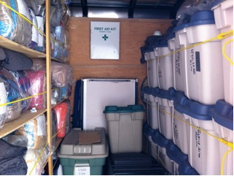
Group Lodging Set-Up
Group lodging kit
Additional equipment and supplies
Function/service areas
Notes:
Depending on size of disaster and response expected, the entire facility may or may not need to be set up. The GL Manager, with the management team, will determine what services need to be set up.
Group Lodging Kits
ESS team puts together during planning stage
Ideally 1 per GL, but if sharing with other GLs, the GL Manager is responsible for making arrangements for delivery of the kit to the GL
Ask: What do you think would be useful to have in a GL kit?
ESS identification: colour coded vests and lanyards, name tags
Sign set, wristbands
Office supplies
Safety equipment: flashlights, cones, power bars
First aid supplies
Personal hygiene supplies
Recreation supplies
Supplier list with contact numbers, function checklists and aids
Additional Equipment and Supplies – some may already be on site
Office equipment
Emergency equipment
Sleeping/Lodging equipment/supplies
Sanitation supplies
Feeding and baby supplies
Water and food
A few of the function/service areas that might be set up
Waiting area for services
Information area (bulletin board, tv, internet)
Check in/out and sign in/out area
Staff quiet and break/lunch area
Emotional support, first aid, sleeping, and eating areas

Slide 20
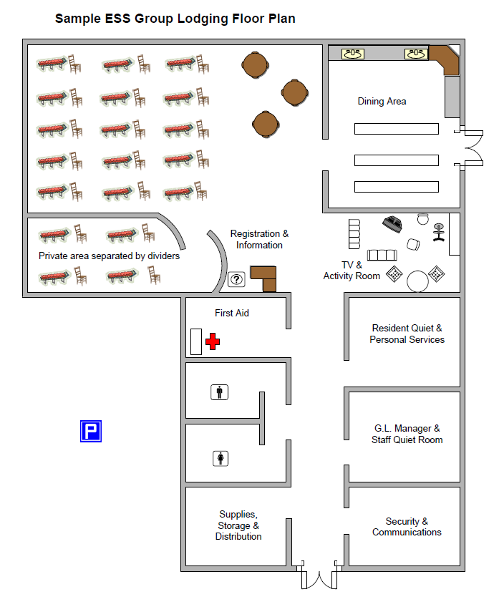
Sample Floor Plan for Facility with Rooms
Notes:
This is is an example of a floor plan for an ESS GL facility with rooms and Figure 4 is an example of a floor plan without rooms, e.g., gymnasium. Keep in mind that these are only examples and the actual set up will be determined by a number of variables. For this reason, it is beneficial to consider optional set ups if the primary one, for whatever reason, is ineffective.
If available, replace the image with a floor plan relevant to the ESS team.

Slide 21
Sample Floor Plan for Facility without Rooms
Notes:
The Public Health Agency of Canada (PHAC)(2007) has set minimum standards of hygiene to provide an environment where the spread of communicable disease is reduced to a minimum. The minimum sleeping area per person is 3.5 square metres (1.5 metres x 2.5 metres) or 40 square feet (5 feet x 8 feet) when possible.
When reviewing allocation space for sleeping, a distance of 0.75 metres (2.5 feet) between beds, bunks or sleeping bags should be maintained. Such spacing has been shown to considerably reduce the spread of respiratory infections. When there is pressure on the use of space, recourse may have to be head-to-tailing of beds.
If available, replace the image with a floor plan relevant to the ESS team.

Slide 22
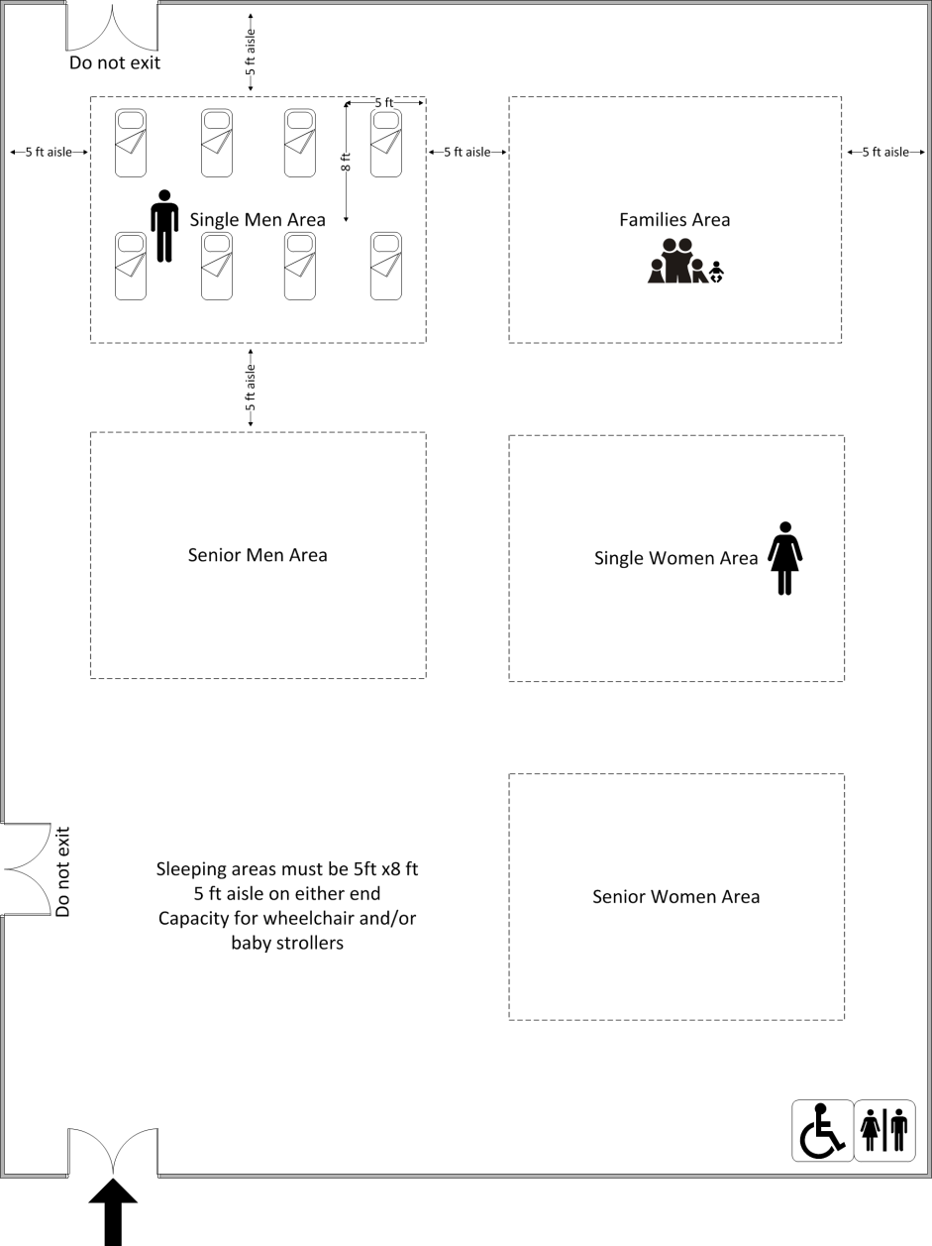
Sample Sleeping Area Set Up (NSEMO 2009)
Notes:
Sample sleeping area set up (NSEMO 2009)
this is a sample sleeping area set up adapted from North Shore Emergency Management Office ESS GL Plan 2009
even when GL is set-up and running, changes in the layout of the GL may be needed to meet the changing needs of the ESS response. Meetings of the GL management team throughout the day will identify issues, challenges, and possible changes of the GL
If available, replace the image with a floor plan relevant to the ESS team.

Slide 23
Sample Sleeping Area Set Up (Kamloops 2003)
Notes:
Review the sample sleeping area.
If available, replace the image with a floor plan relevant to the ESS team.

Slide 24
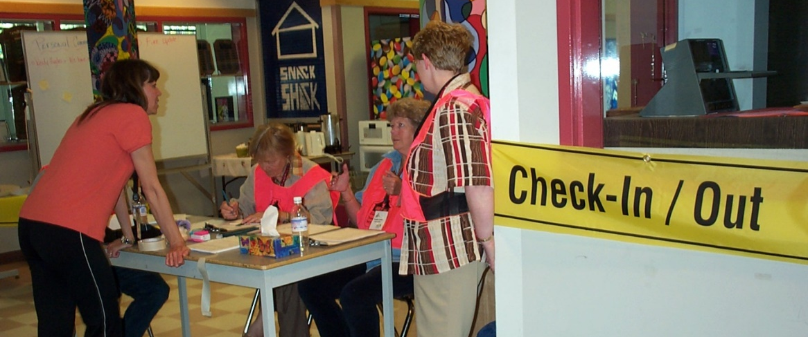
Guidelines
Notes:
Guidelines for working in group lodging
Describe how to respond to some common challenges in group lodging
The participant guide has some sample guidelines that were adapted from the City of Richmond, North Shore Emergency Management Office, and the City of Vancouver in 2010 ESS Regional Group Lodging Field Guide.
Care homes – GL may not be suitable so generally they have their own contingency plans for evacuation. If they are evacuated to GL, care home staff are responsible for their residents and medical concerns. Settle anxious ones in a quiet area with one-on-one support
Check in/out vs. sign in/out – check in/out occurs at the beginning and end of an evacuee’s stay. Residents must sign in/out when coming and going from the premises so they can be accounted for in an evacuation. An example of a Check In/Out Process (from the City of Richmond, North Shore Emergency Management Office, and City of Vancouver Regional Group Lodging Plan) and Sign In/Out Log can be found in Appendix B
Children:
Should be supervised by their parents/ guardians at all times
A minimum of 2 qualified and licensed child care workers can look after children at the GL for short periods of time while they are completing paperwork
If they are separated from their caregivers and arrive at the GL, let your supervisor know (the provincial/territorial children’s office has responsibility for them; in BC, it’s MCFD)
Can only be released to their parents, adult siblings, legal guardians – not to neighbours, family friends, or other relatives
Suspected abuse should be reported to your supervisor
Disputes – everyone is to be treated with respect, without discrimination. If evacuees are not comfortable staying in GL under those terms, they can make alternative shelter arrangements. Notify your supervisor or security, or call the police if your safety is a concern
Drugs & Alcohol – not allowed in the GL. Sometimes, medical issues may present like intoxication. If you are unsure, ask First Aid to assess.
Food Donations – cannot accept food from the general public due to health regulations. Food can be accepted from restaurants because they are Foodsafe certified, however, if a restaurant wants to contribute, vouchers are better. Make sure that the restaurant is not asking for compensation for these donations before accepting them
Internal Communications – some ways of communicating in the GL include bulletin boards, memos, shift change briefings, staff meetings, and training (sometimes training is on the spot)
Language/Translation – Someone close to the family, other evacuees, or staff on site may have translation skills. The ESS Translation Guide (link is in Appendix B) provides translations for typical questions in various languages
Media – GL is equivalent of a private residence and only registered guests are permitted to enter. Direct media to speak with the Information Officer or ESSD. If they are off site, provide them with contact information. If media insist on speaking with residents, advise them you will ask residents if they would like to speak to the media – outside the GL
Medical Issues – health care professionals can be brought in to educate about non-infectious diseases. Residents behaving strangely can be referred to Emotional Support or if not activated, then advise your supervisor. Prevention of the spread of infectious diseases is very important. There are steps to contain a situation on p. 44 of your guide
Pets – are generally not allowed with the exception of registered assistance animals due to health regulations and allergies. Some local authorities have access to larger facilities and may allow pets in a separate room. If not allowed and people refuse to stay in the GL without their pets, then they are choosing not to stay in GL
Privacy – respects each other’s privacy; limit social media photos and posts to their personal experience only. Tents are not allowed
Sanitation Standards – p. 45 of the guide has standards for water usage, dust control, and garbage collection
Security – is there for directing traffic and movement into the facility, establishing security patrols and night watches. They need to have a list of all residents with them. Fire drill should be reviewed with every evacuee at the time of check in
Sleeping area – there is some information about reserving beds, moving cots, sharing cots, and lights out for shift workers on p. 46
Smoking – is permitted in designated outside areas only
Standards of Conduct – sometimes referred to as Resident Information Sheet, should be posted in a prominent area and given to each evacuee. It can be found in the GLOG (Link to GLOG is in Appendix B)
Vandalism – address issues with the parent or guardian if a minor is involved. If necessary, contact security or police
Volunteering to Help – encourage residents to help. There are many jobs that do not require special training. Residents who help maintain the GL can develop a sense of belonging and take more responsibility for their actions. Remember, 85% of jobs in the GL can be done by residents!
Worker Care – you will be informed, educated, and supported, but if you are having difficulty with your workload, advise your supervisor. Responders need to look after themselves in order to be able to help others. You are never alone. Ask your supervisor if you are unsure.

Slide 25
Demobilizing
When certain functions are no longer needed, your supervisor will advise when it’s time to demobilize or deactivate.
Each function has a demobilization checklist.
Checklists are available in the Group Lodging Operation Guidelines to ensure all the necessary tasks are completed before you leave.
Notes:
When certain functions are no longer needed at GL, your supervisor will advise of when it is time to demobilize. Use the function checklist to ensure you complete all of the demobilization activities before you leave. There are usually function specific activities as well as general activities such as the following:
Identify/bring forward demobilization issues related to your assigned function
Ensure incomplete/open actions are reported to your supervisor
Complete all required forms, reports, and other documentation and submit all forms through your supervisor to the Planning Section, as appropriate, prior to departure
Return equipment/supplies
Clean up/organize your work area before leaving
Participate in exit interview/debrief
Sign out with Volunteer/Staff Management Branch
Leave a forwarding number
Access critical incident stress debriefing as needed
Prepare to contribute to any post event processes (e.g., post-operational debriefs, after action reports etc.)

Slide 26
Group Lodging Scenarios
In Small Groups
As a member of the local ESS team, you may encounter some of the following challenges when working in a GL facility.
Discuss what you would do in each of the provided scenarios.
Notes:
Activity: Addressing Challenges (10 minutes)
Objective: Give participants the opportunity to discuss what they would do in certain group lodging scenarios.
Setup: Direct participants to review and discuss answers to the scenarios in their participant guide.
In Small Groups
As a member of the local ESS team, you may encounter some of the following challenges when working in a GL facility.
Discuss what you would do in each of the provided scenarios.
.
Debrief (10 minutes)
Discuss answers as a group.

Slide 27
Any remaining questions about the content?
Notes:
Group Discussion: Any remaining questions about the content?
Ask the participants if they have more questions before the scenario and evaluation.

Slide 28
Quiz
Get into small groups. Turn to the Course Completion section of your Participant Guide. Complete the quiz with your groups, with a score of 70% or above. You can take the quiz as many times as you like.
Notes:
OPTIONAL SLIDE
Adjust this slide based on which option(s) you are selecting for course completion. Use the instructions on the slide, or replace them with one of the following options. If not using a quiz for course completion, omit this slide.
Complete the quiz in the Course Completion section of your Participant Guide, with a score of 70% or above. You can take the quiz as many times as you like.
Turn to Course Completion section in your Participant Guide, we will discuss the quiz questions together.
To complete this course, take the quiz online with JIBC. Follow the instructions at the back of your Participant Guide.
The quiz can be completed as a large group, in small groups, individually or online. The online course may take a few hours to register, so if choosing this option, we recommend students register before the course session or you ask them to complete it on their own within a few days of the course ending.
See the Course Materials Guide and ESS Course Completion Guide for details on Course Completion.

Slide 29
Closing Activity
What is one thing you understand well after the course?
What is one thing you want to learn more about?
Notes:
Activity Objective: For participants to learn about the strengths of their peers, and to self-reflect on their learning
Optional Group Discussion: Go around the class and ask the students to name one thing they learned well, and one thing they want to learn more about.

Slide 30
Course Completion Forms
To have course completion recorded by JIBC:
Fill out the ESS Course Completion Form and Student Information Form* in your Participant Guide and return it to your facilitator.
After JIBC enters the information into the student records system, the paper copies will be destroyed.
*You only need to fill out the Student Information Form if you don’t have a JIBC student number
Notes:
Note for All Facilitators
This Student Information Form and ESS Course Completion Form is required by all students in order to have course completion recorded on their JIBC student transcript.
If students do not complete all the information on this form, the course completion may not be recorded.
These forms are in the back of the manuals. Instruct the students to rip out the forms and provide them to the facilitator. The facilitator must provide the forms to the ESSD, EPC, or designate to be sent to JIBC.
Do not photocopy these forms. Photocopied forms may not be accepted.

Slide 31
Thank you!
Information about the JIBC ESS Training Program
Website: jibc.ca/ess
Email: ess@jibc.ca
Notes:
Note to Community Facilitators
This is an optional slide for community facilitators.
If you wish to add or modify the information on this slide, please do so as you wish. You are not obligated to further promote JIBC courses, but it is recommended as this is where the ESS program is developed and administered.

